Slide 1
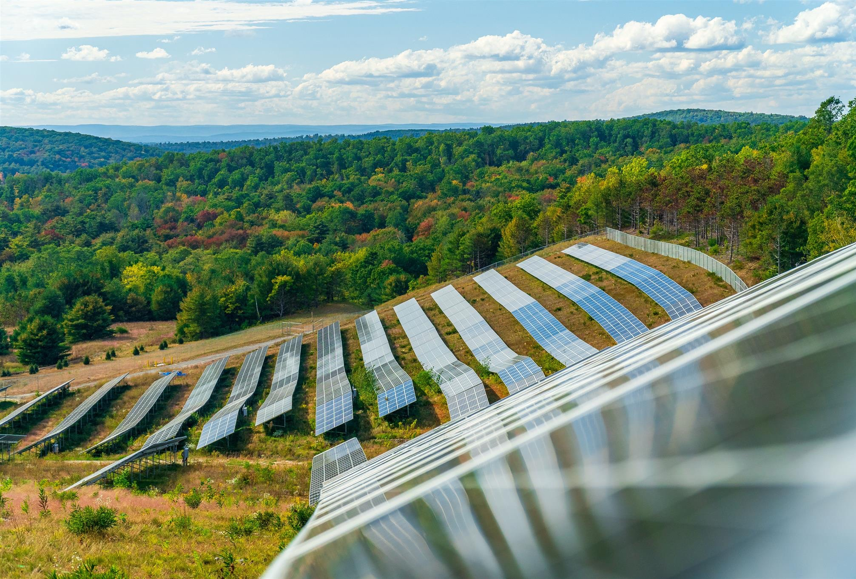
N E X A M P . C O M
Wilson Hill Solar – Hoosick, NY
February 2024
We’re making decarbonization easy
and accessible for generations to come.
G E T T O K N O W U S
|
N E X A M P 2 0 2 4

Slide 2
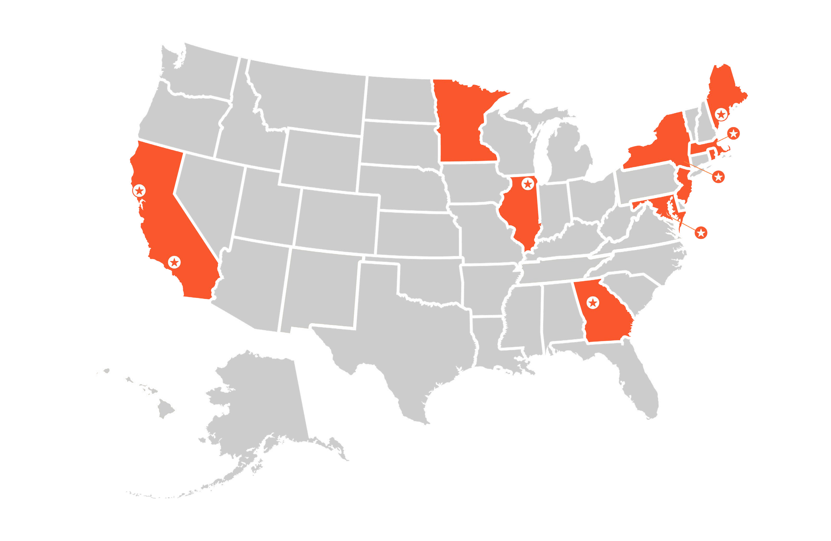
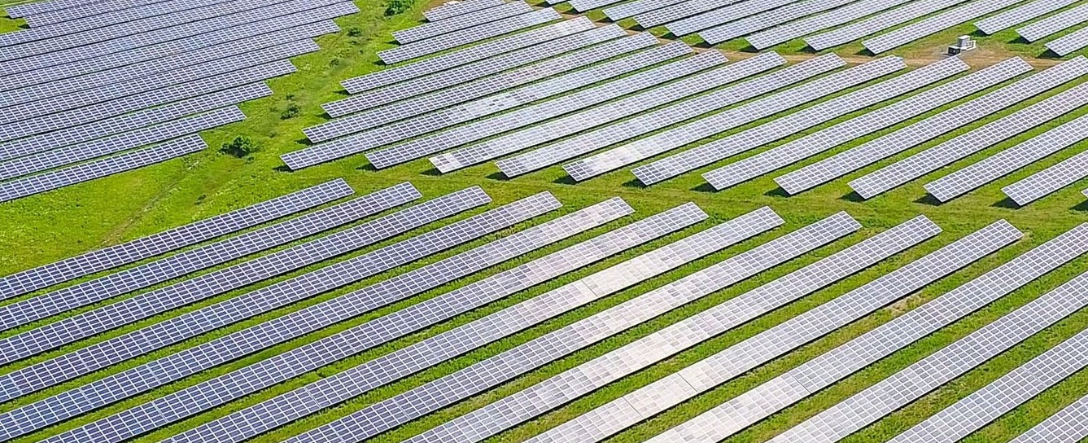
About
Nexamp
O U R L O C A T I O N S
O U R O F F I C E S
Get To Know Us
Nexamp is harnessing positive power and funneling it back into communities across the country, maximizing our social and environmental impact daily.
National company headquartered in Boston
Vertically integrated solar energy and storage company
Develop, manage, and maintain community solar farms nationally
Lead with inclusivity and equity
Founded in 2007 by two United States Army Veterans
Notes:
Ryan

Slide 3
B Y
T H E
N U M B E R S
Achieving growth across all business units.

Slide 4
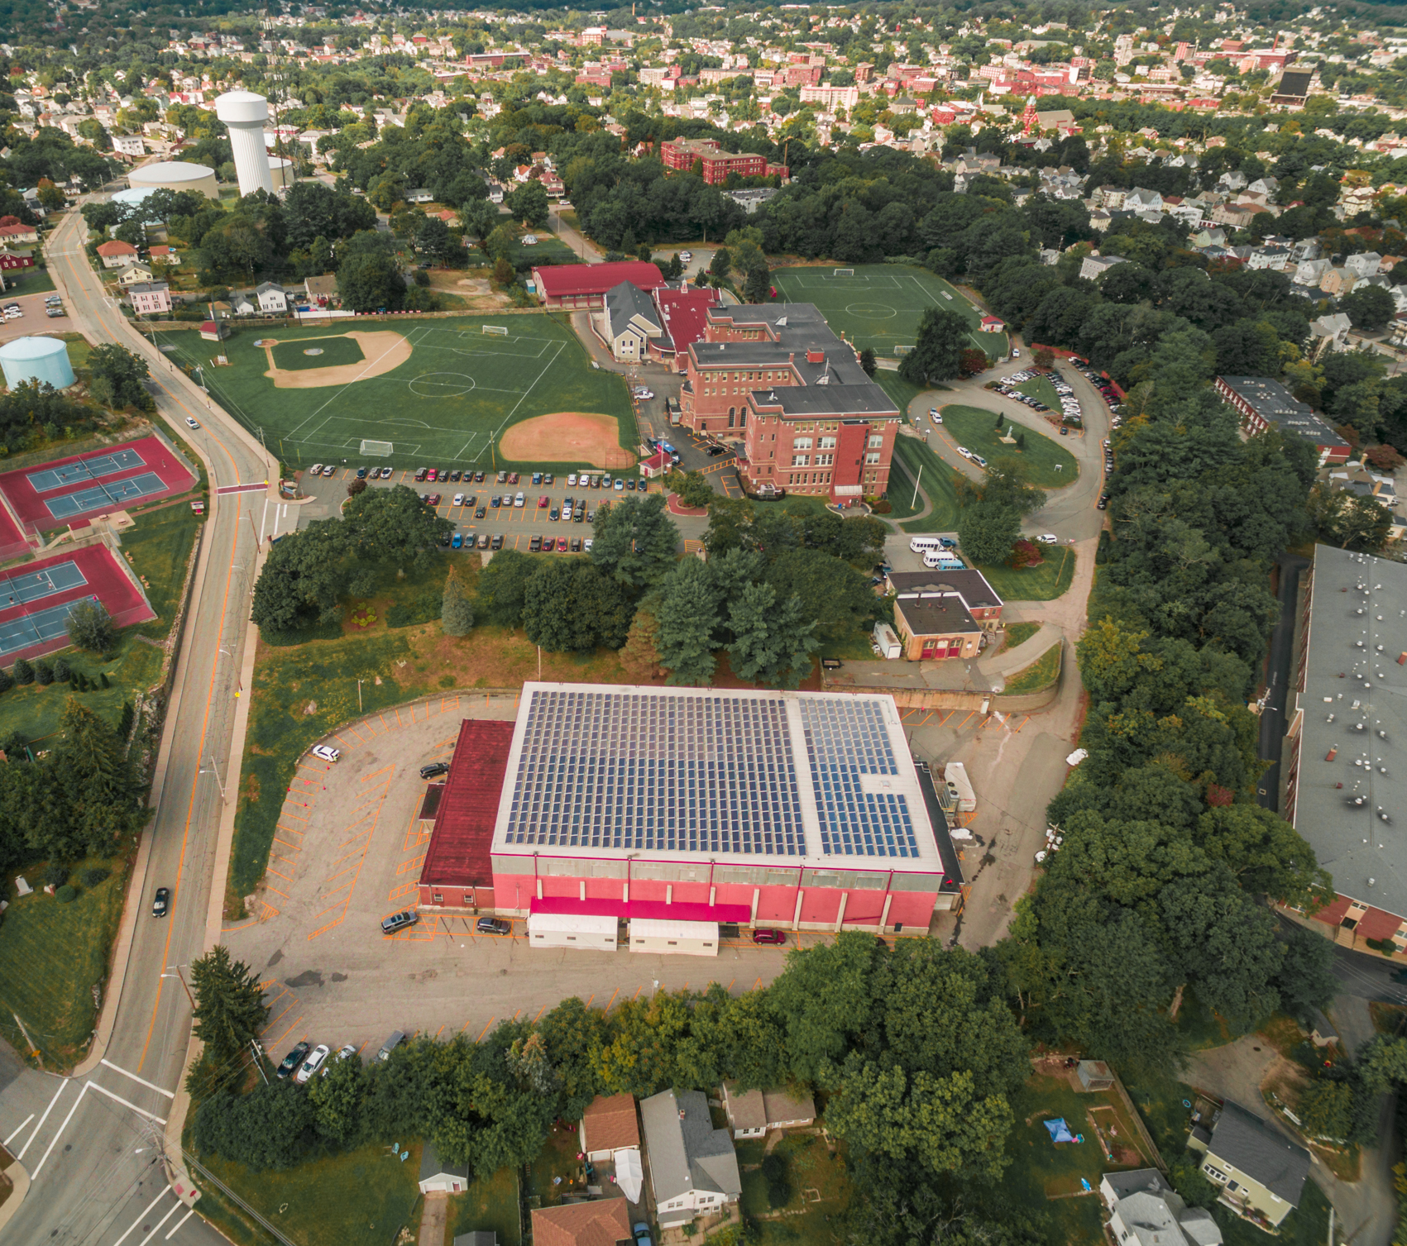
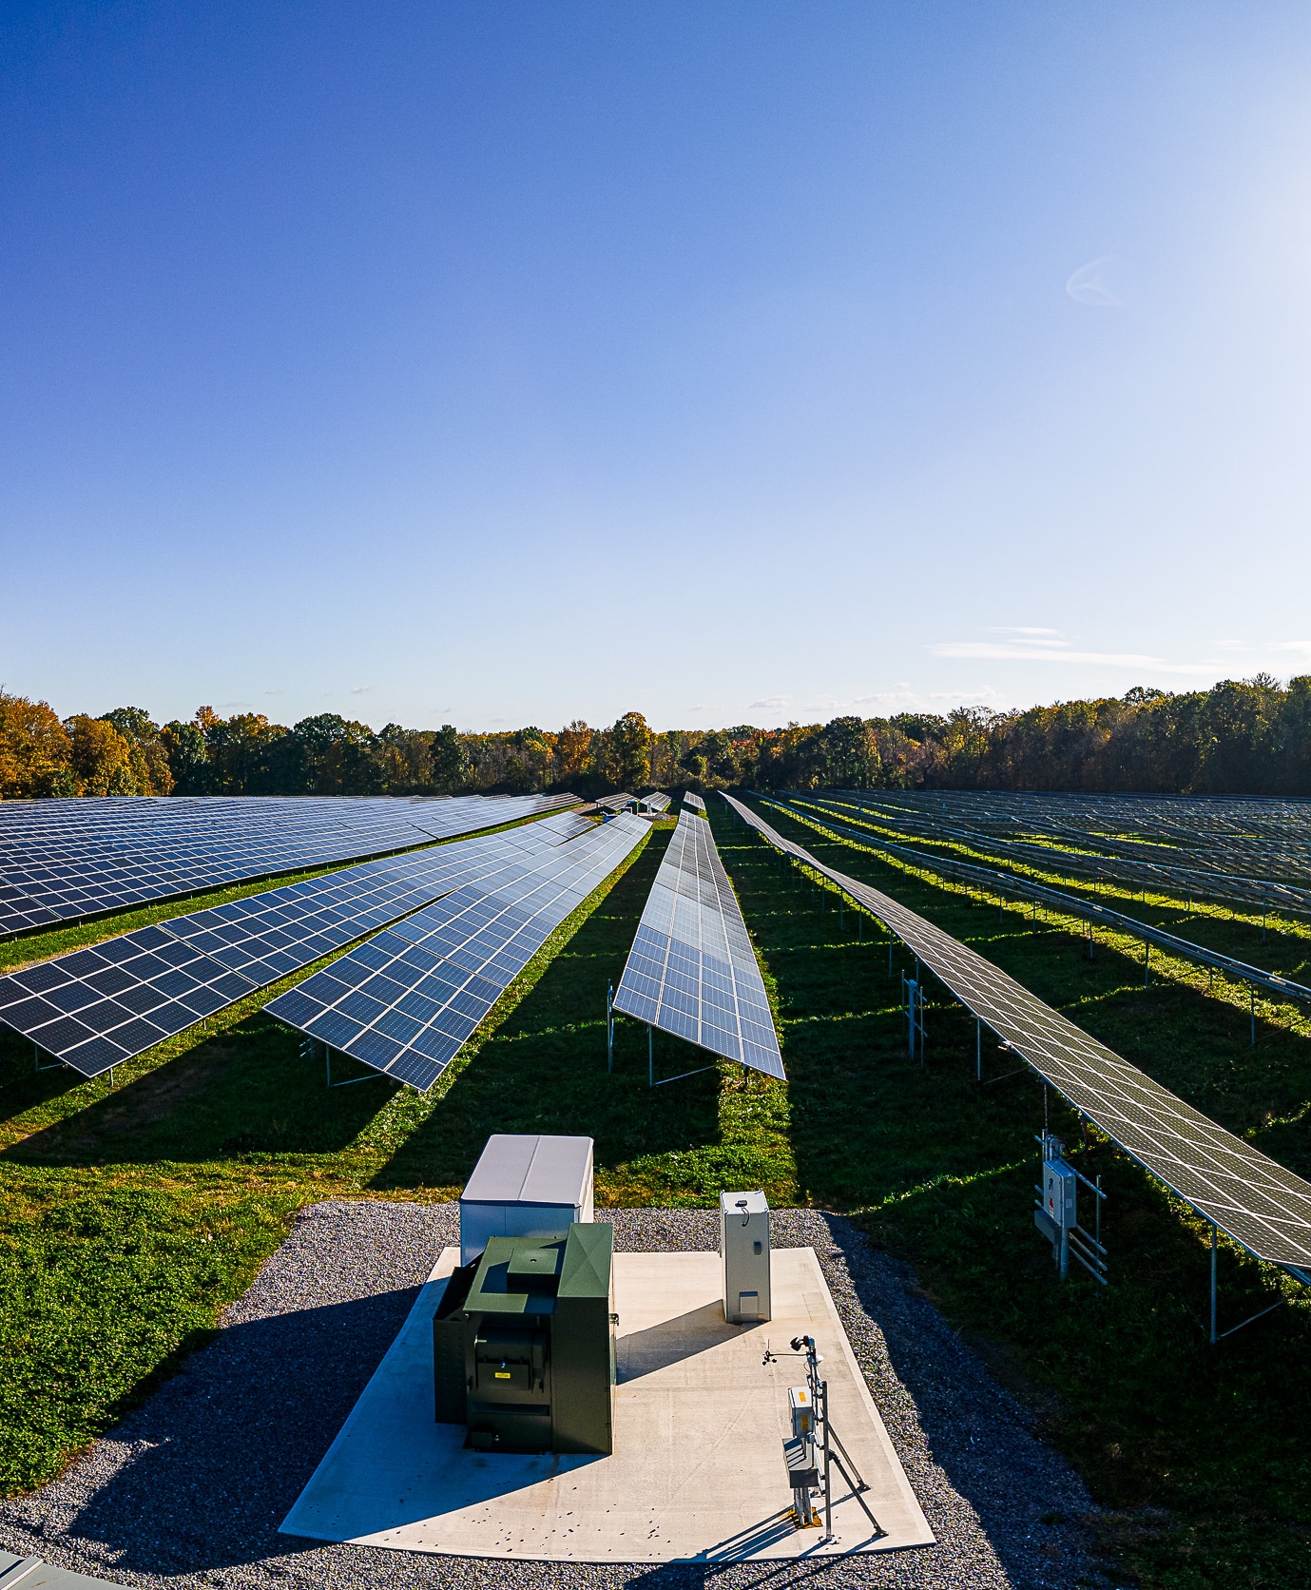
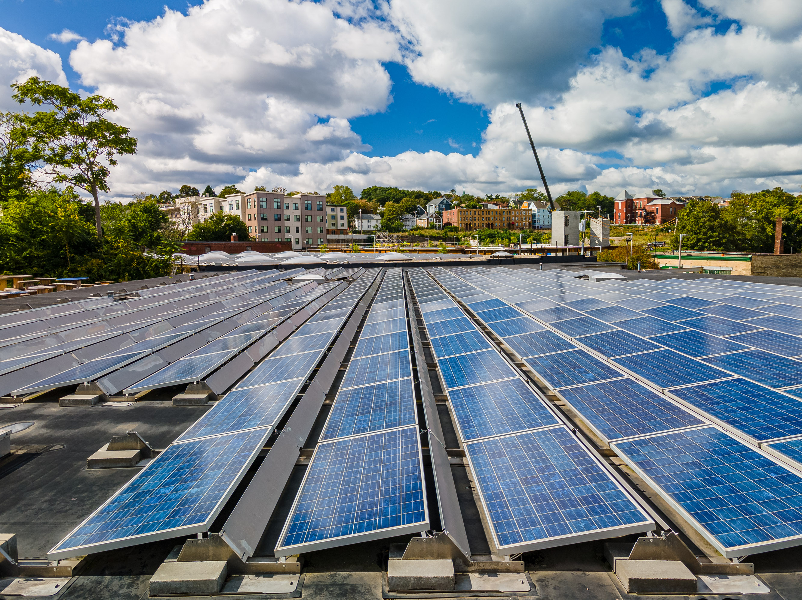
Regional Experience.
In the State of NY Nexamp has over 600 MW of projects either operating or in development.
Currently operational or under construction in NY:
5 Rooftop Projects
11 Energy Storage Projects
4 Brownfield Sites
37 Traditional Sites

Slide 5
How Community Solar Works

Slide 6
Substation Data

Slide 7
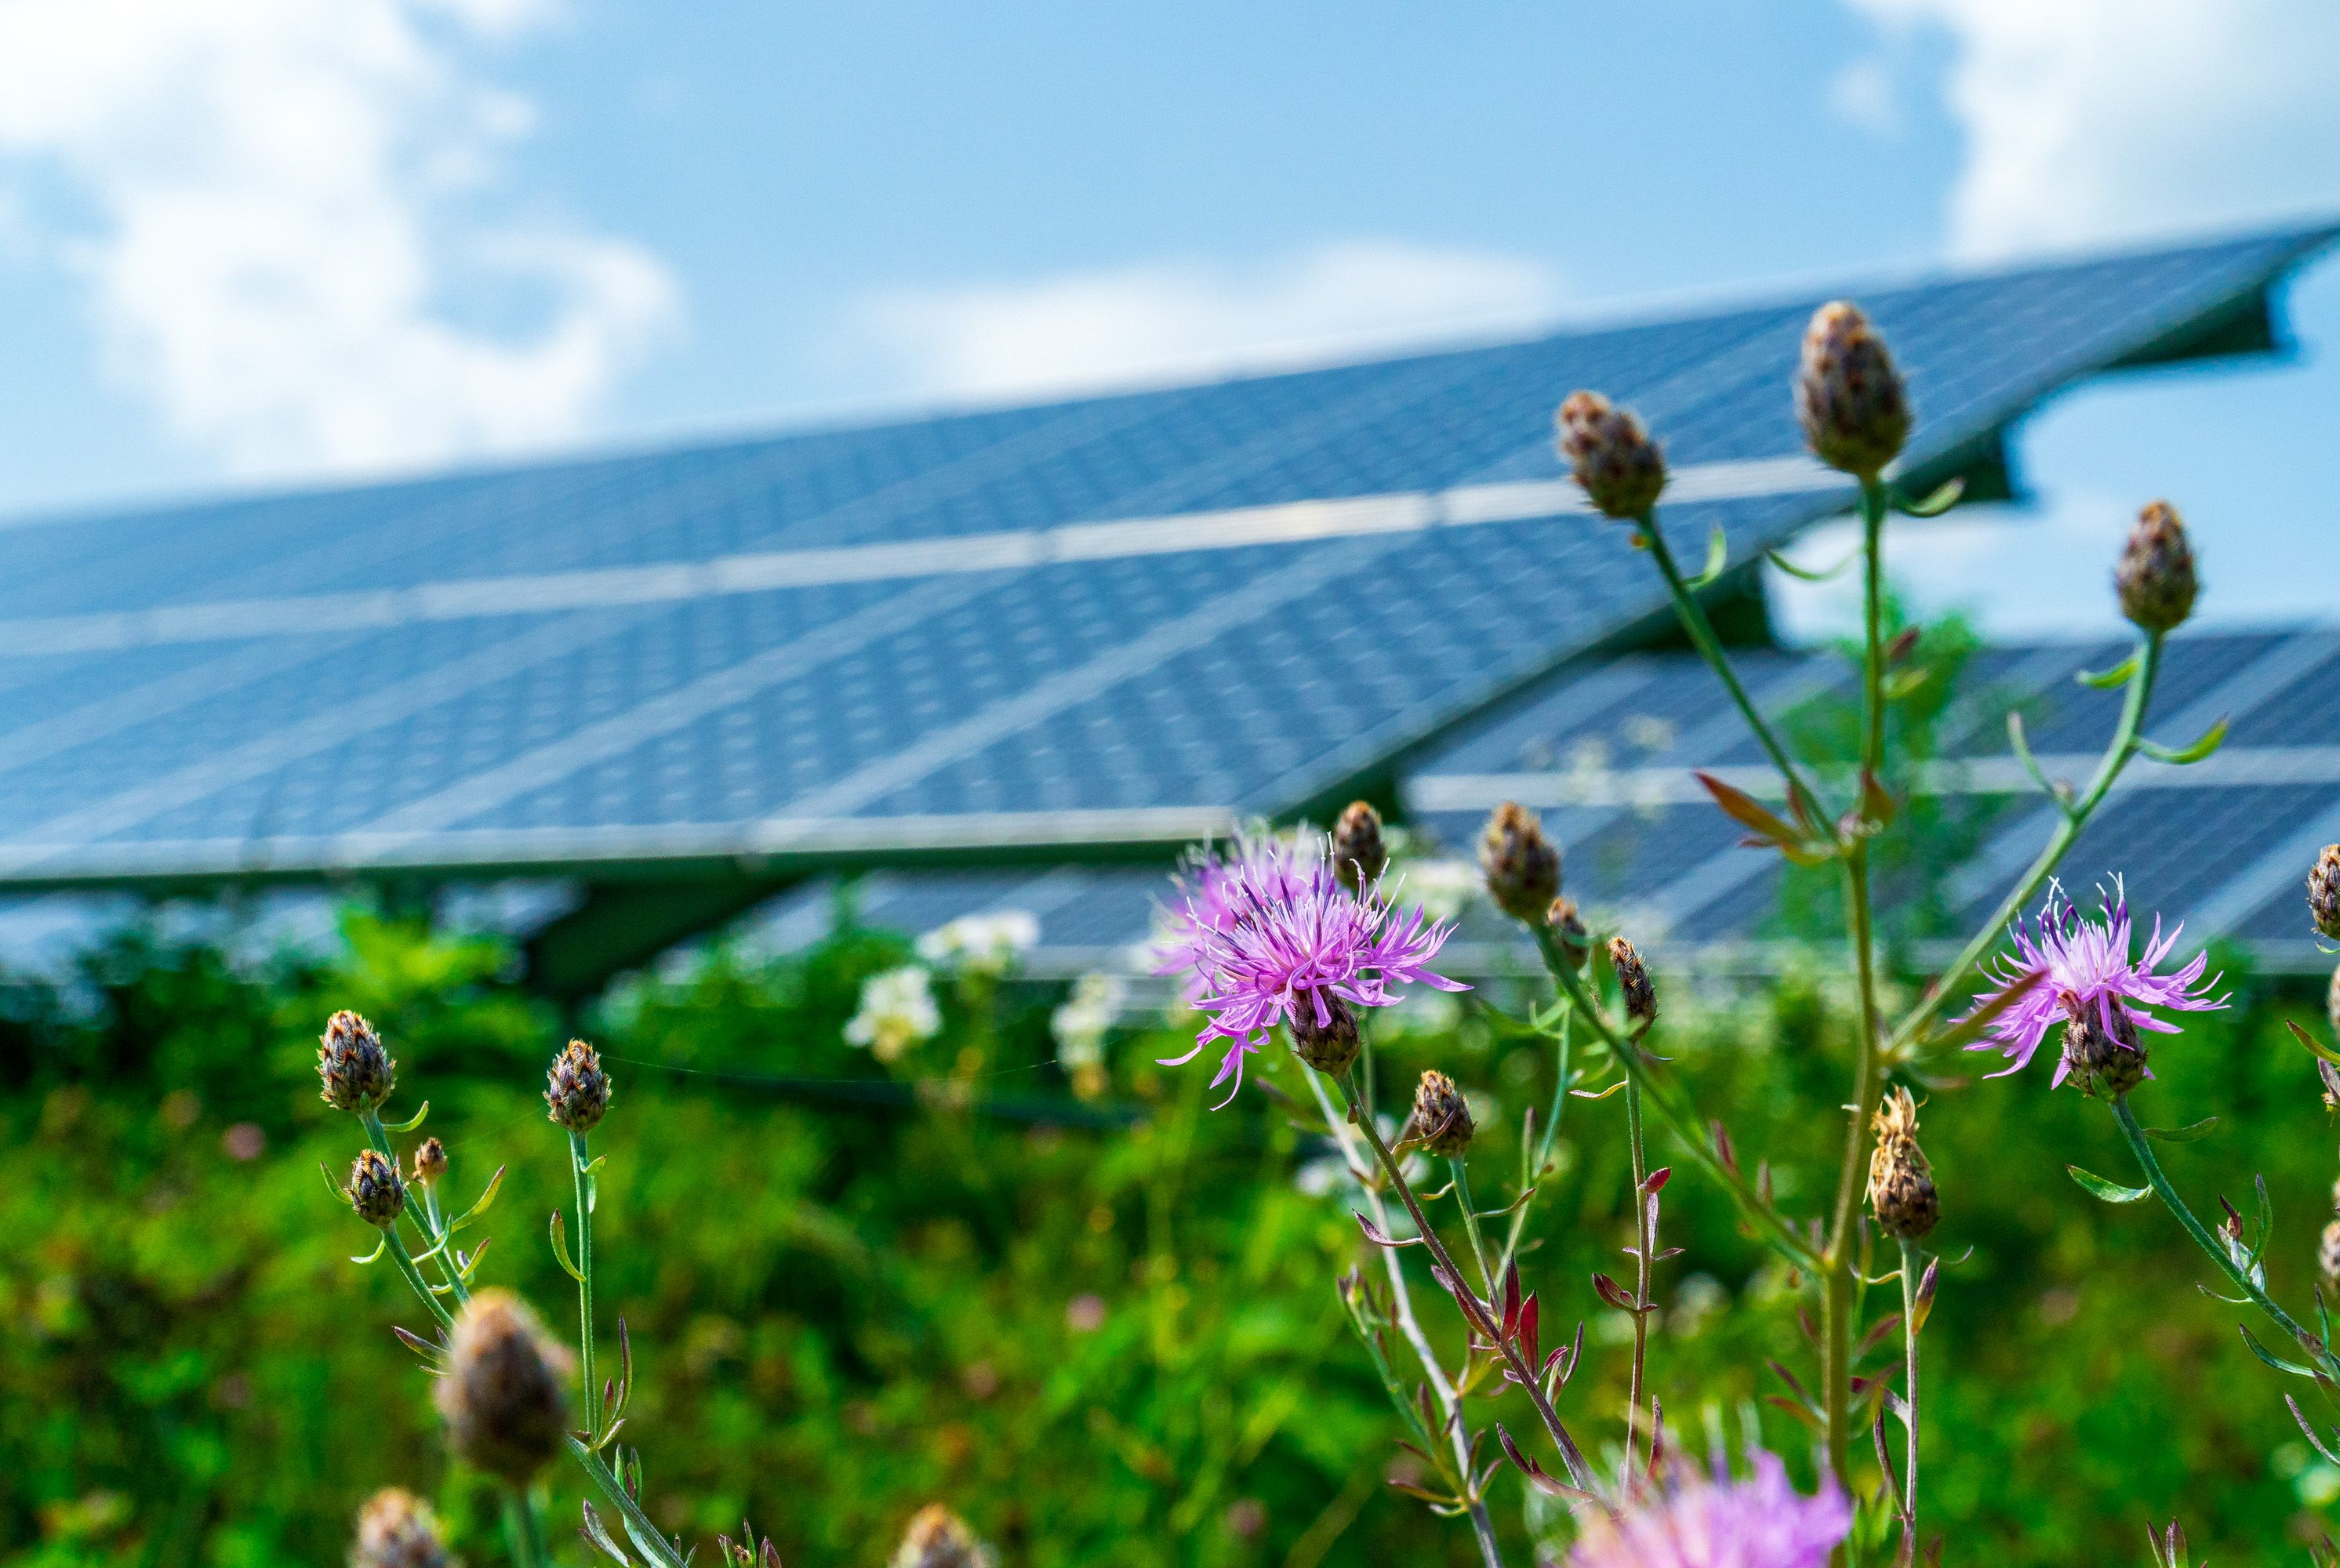
Wilson Hill Power Output
The Average home in New York State uses 6,864 kilowatt-hours (kWh) of electricity per year
The specific production for this facility will be 8,715,589 kWh
On average, this facility will produce enough power for 1,269 homes.

Slide 8
Pros and Cons of Community Solar
PROS:
Energy produced without carbon emissions
Savings for subscriber energy bills – everyone is eligible to become a subscriber
Increase in tax income to municipality and county
Lowers average energy rates – as solar is one of the cheapest forms of electricity per the PSC’s rate chart.
Electricity will be produced for community consumption
Grid Reliability
Energy independence
Building expertise and economies of scale
CONS:
Visual Impact (mitigation strategies are available)
Temporary removal from agricultural use
Notes:
STA; mitigation strategies, such as plantings, etc., can be employed to help shield the array to the greatest extent practical.

Slide 9
Project Timeline

Slide 10
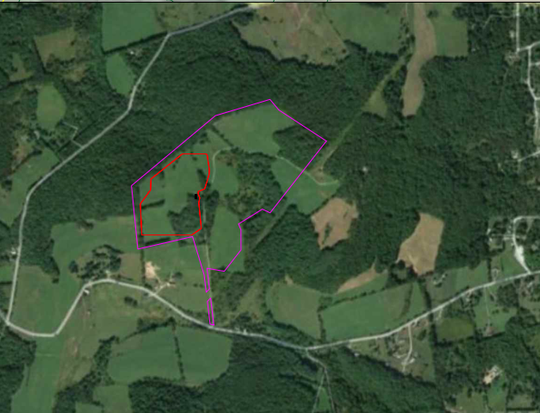
Introduction
Wilson Hill Solar is a 5 MW ac generating facility occupying 19.19 acres of a 99.52 acre parcel at 469 Wilson Hill Road, owned by Larry Bugbee. The project has been studied and approved by National Grid for interconnection, and the first payment has been made.
The southern facing slope is well obscured by existing foliage, and visual impacts are expected to be minimal. Access to the site will be from the existing cell tower road, which will be expanded and improved. A temporary access road will be utilized during construction near the interconnection point located on an adjacent parcel owned by Mike Mattison.
Wilson Hill Road
Wilson Hill Road
Notes:
Post construction, a stub pervious access road will be left in place to allow National Grid access to the point of interconnection and the proposed utility poles along Wilson Hill Road.

Slide 11
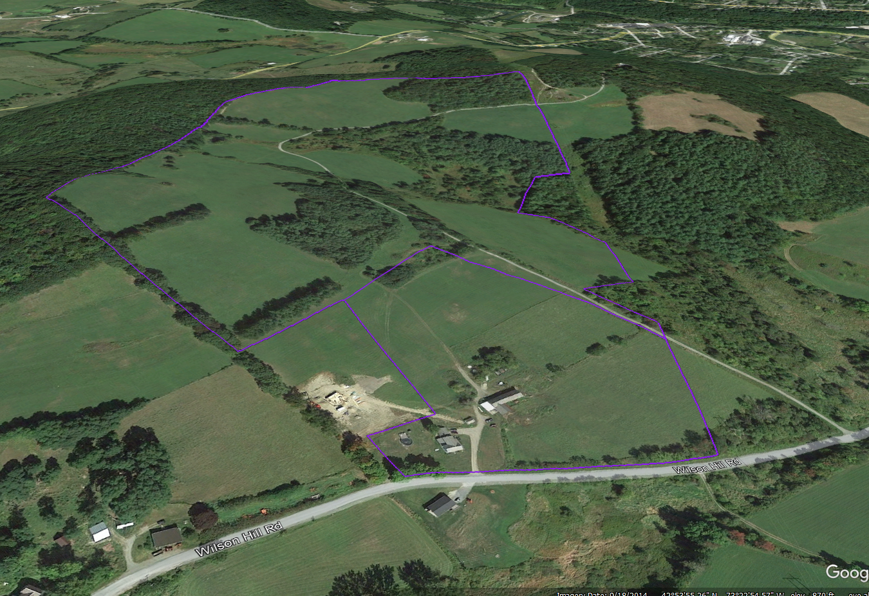
Current Site Condition
The properties are zoned agricultural/residential under the Town of Hoosick’s zoning code, and solar is an allowed use subject to special permit approval under the jurisdiction of the Town’s Zoning Board.
The parcel is predominantly cleared, with minimal tree removal required. The parcel has been used primarily for agricultural uses, and sites a cellular tower at the far east end of the property, away from the array. The surrounding land uses include agricultural residential and utility-owned transmission lines.

Slide 12
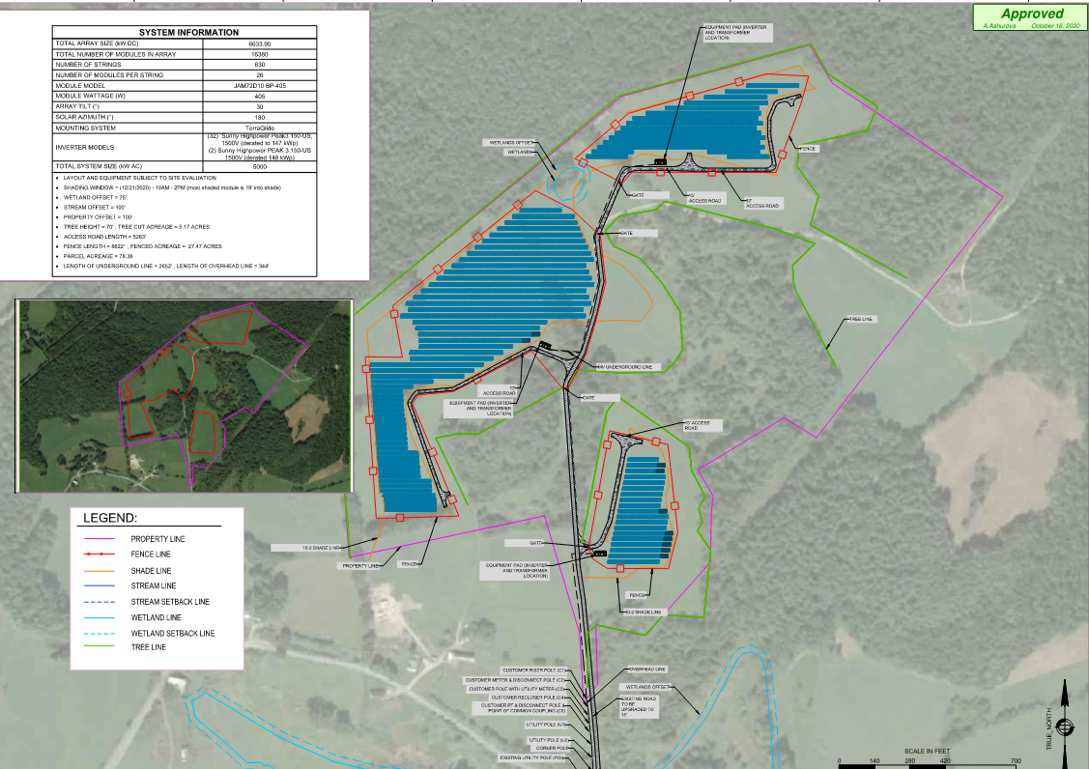
First Pass
Our initial design prior to survey had the project sited deeper onto the site. However, after obtaining the topographical survey, we found that there was a much more limited footprint available for the project.
Wilson Hill Road
Wilson Hill Road

Slide 13
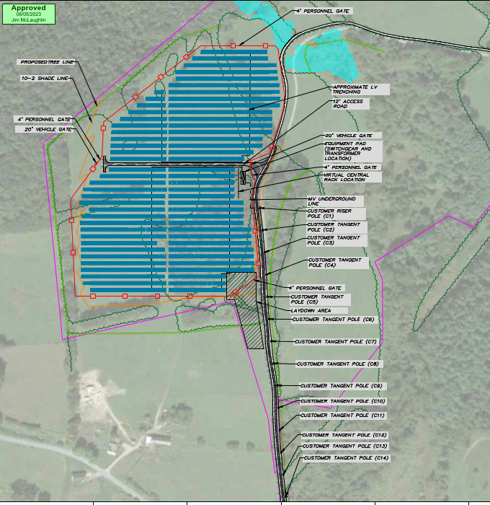
Second Pass
After Survey, we settled on a plan that would best suit the site, while still preserving natural foliage coverage on many sides of the project.
Wilson Hill Road
Wilson Hill Road

Slide 14
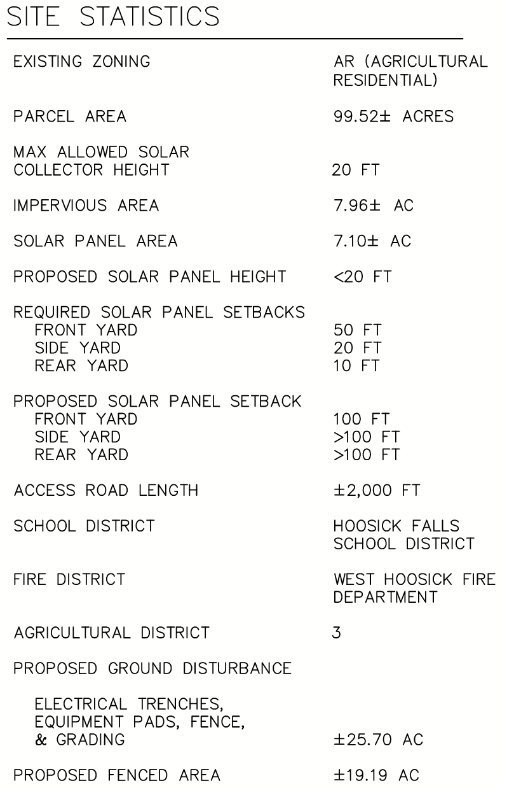
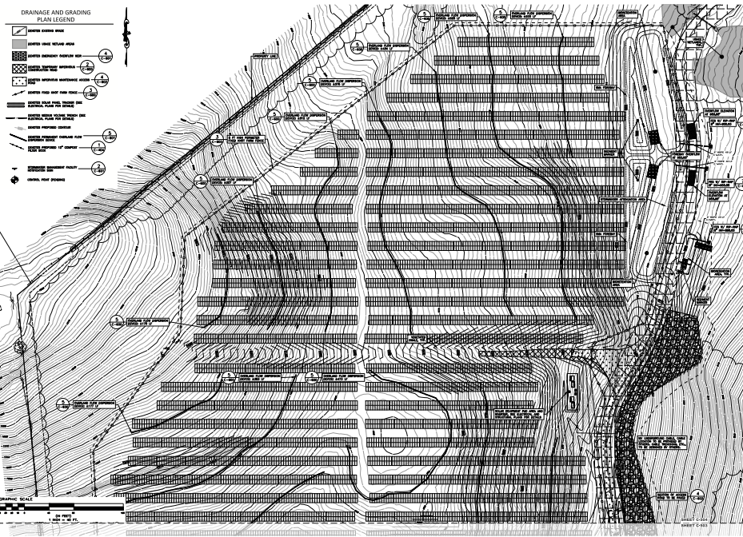
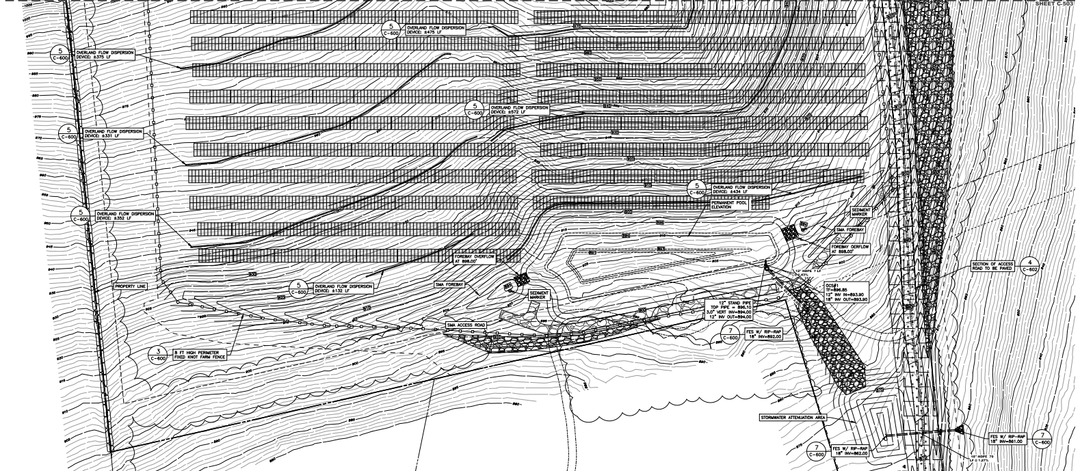
Current Plan
The 5 MW ac solar facility will be composed of 585w solar panels mounted to fixed solar racking. A new curb cut will facilitate a 20-foot gravel access road to provide access for construction, and then be removed. A utility access stub road will remain on the secondary parcel for the duration of the project, allowing connection to National Grid’s distribution level infrastructure on Wilson Hill Road. However, maintenance access will be provided from the existing access road on the primary property. The total area disturbance is approximately +/-25.1 acres with 0.8 acres of impervious surface, and +/-7.1 acres of tree clearing and grubbing.
As a requirement of the utility, on-site electrical
interconnection and distribution lines will be placed above ground on telephone poles. Medium voltage lines will proceed from the Interconnection point to the facility underground. Nexamp is utilizing a 75-foot setback minimum on the project, but in most areas is greater. An 8-foot fixed knot farm fence will be erected to prevent unauthorized access to the array equipment.
Notes:
The 5 MW ac solar facility will be composed of 585w solar panels mounted to fixed solar racking. A new curb cut will facilitate a 20-foot gravel access road to provide access for construction, and then be removed. A utility access stub road will remain on the secondary parcel for the duration of the project, allowing connection to National Grid’s distribution level infrastructure on Wilson Hill Road. However, maintenance access will be provided from the existing access road on the primary property. The total area disturbance is approximately +/-25.5 acres with 0.8 acres of impervious surface, and +/-7.1 acres of tree clearing and grubbing.
As a requirement of the utility, on-site electrical interconnection and distribution lines will be placed above ground on telephone poles. Medium voltage lines will proceed from the Interconnection point to the facility underground. Nexamp is utilizing a 75-foot setback minimum on the project, but in most areas is greater. An 8-foot fixed knot farm fence will be erected to prevent unauthorized access to the array equipment.

Slide 15
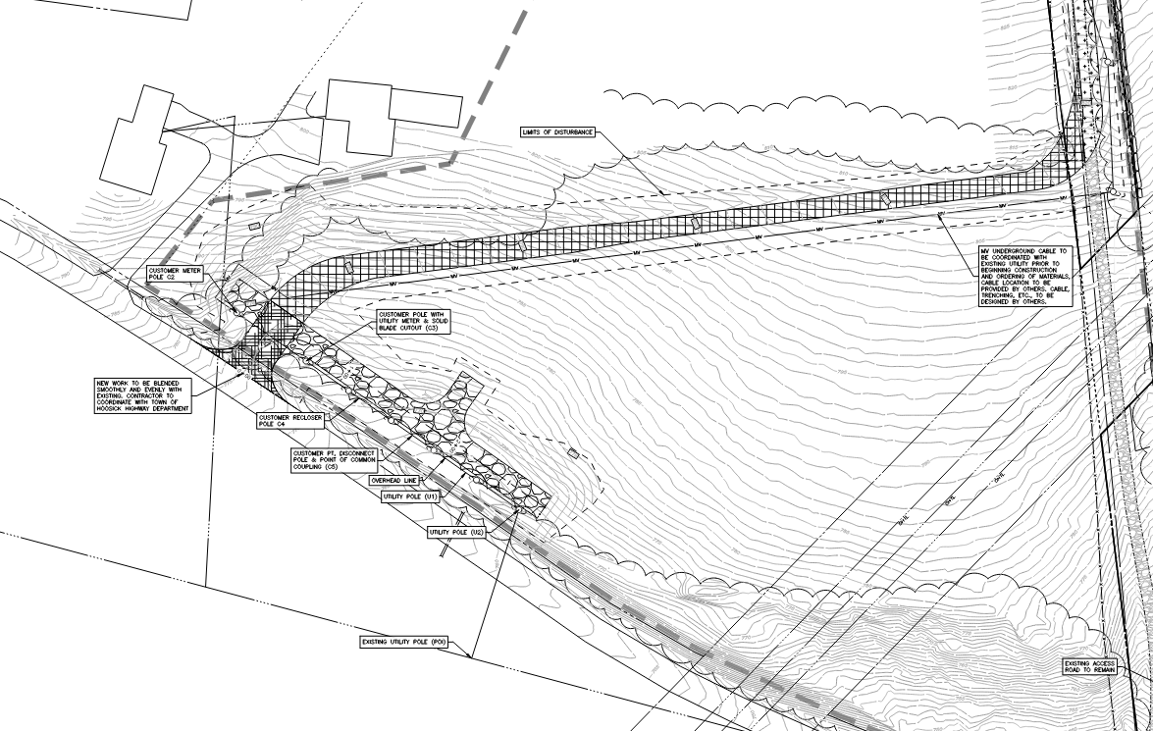
Site Development
The design team has worked hard to protect the natural conditions of the property. The project avoids any wetland disturbance, minimizes tree clearing, and is utilizing existing roads for long term access. Temporary construction access will be created via an adjacent property, with only a portion remaining permanent for utility access to interconnection equipment. The design also has strived to most appropriately site stormwater management features to not upend the site’s character.

Slide 16
Timeline
June ‘23
Our first meeting with the ZBA was an introductory meeting, before submitting any formal documents. We utilized the ZBA feedback and revised and strengthened our application.
Sept ‘23
Our submission was made in August ahead of the September meeting. After hearing the concerns regarding the Hawthorn project, we amended our application to better satisfy anticipated comments for October.
Nov ‘23
Received comments from the board:
SEQR coordinated review notice started on 10/15 – to be complete by 11/15
Planting buffer requested
Request for assessment studies
Request for visual simulations
Request for toxicity study
Request for voltage information
Laberge notes that this is a very complete application and that we’ve produced an extensive amount of information.
Wilson Hill Road
Wilson Hill Road
Dec ‘23
The requested materials were prepared from November were submitted ahead of this meeting. Due to FOIL allegations, the meeting was postponed.
Jan ‘24
The board did not have sufficient time to review the submitted documents. Additional comments were provided and additional materials were requested. I will address these over the following slides.
Notes:
STA: Sept, 23: Would it be worth noting that after the concerns were heard regarding the Hawthorn project; the application was amended?

Slide 17
Addressing Comments

Slide 18
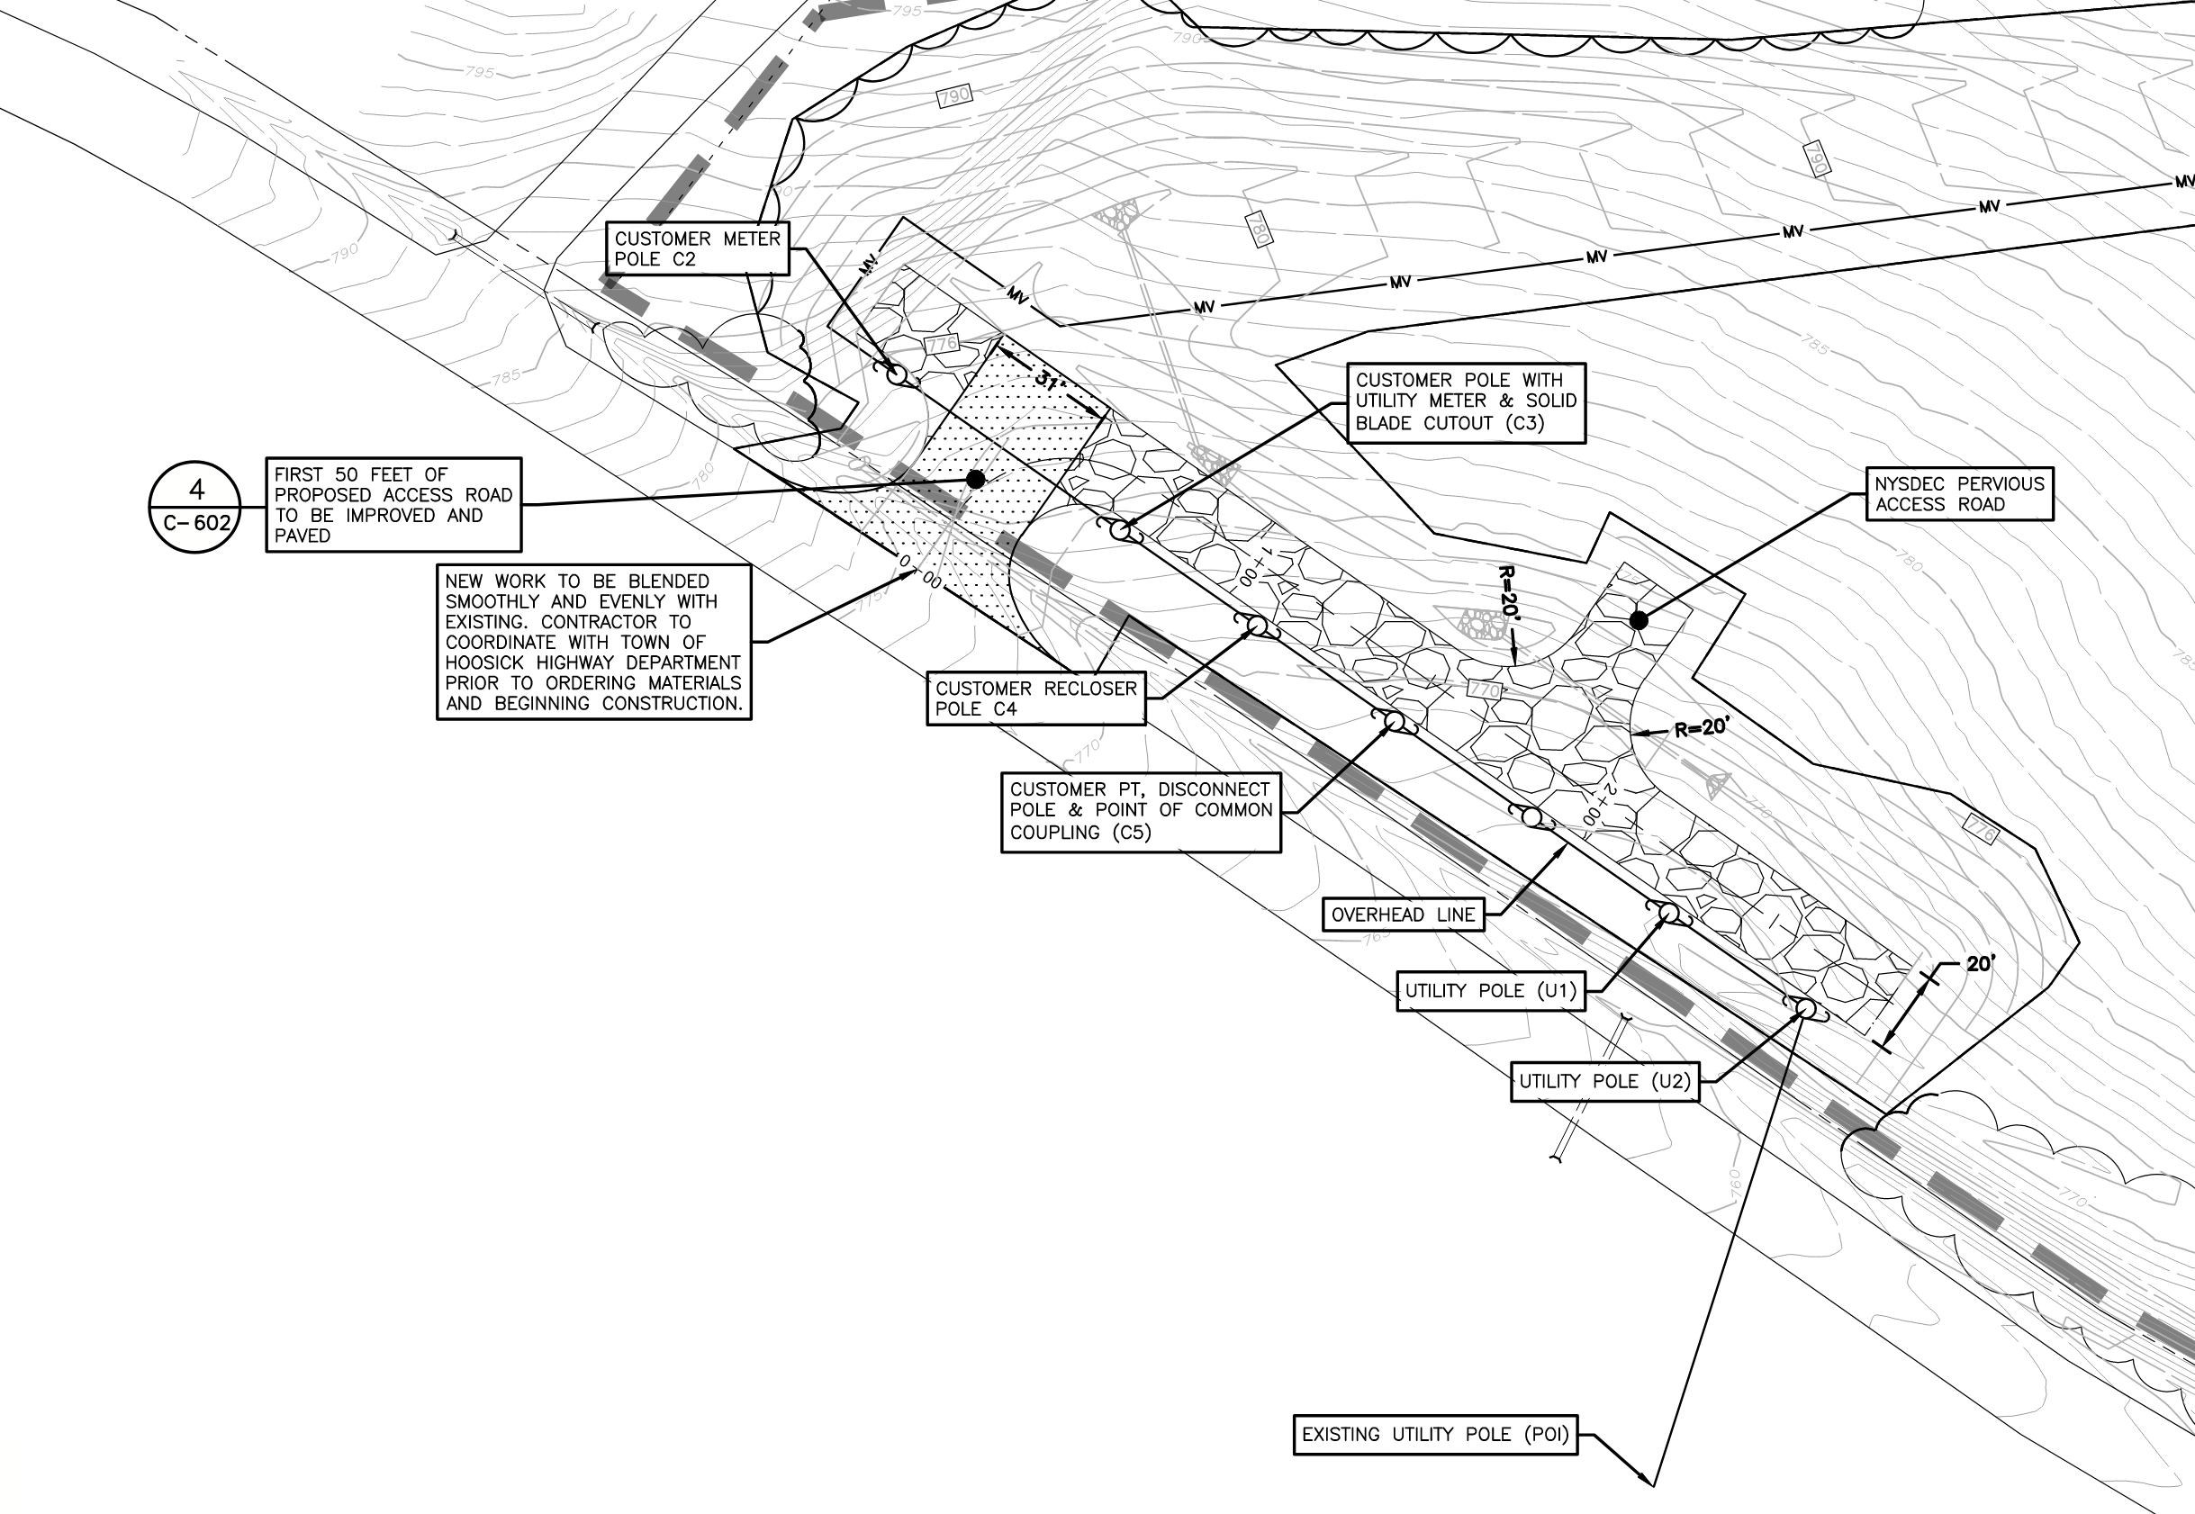
Comments from January
IX
Detailed drawings of the power interconnection plans including visual representations of the above ground planned infrastructure on the site (wires, poles, transformers, etc). Plans were provided in December, 2023, visual analysis has been included with this submission.
Wilson Hill Road
Wilson Hill Road

Slide 19
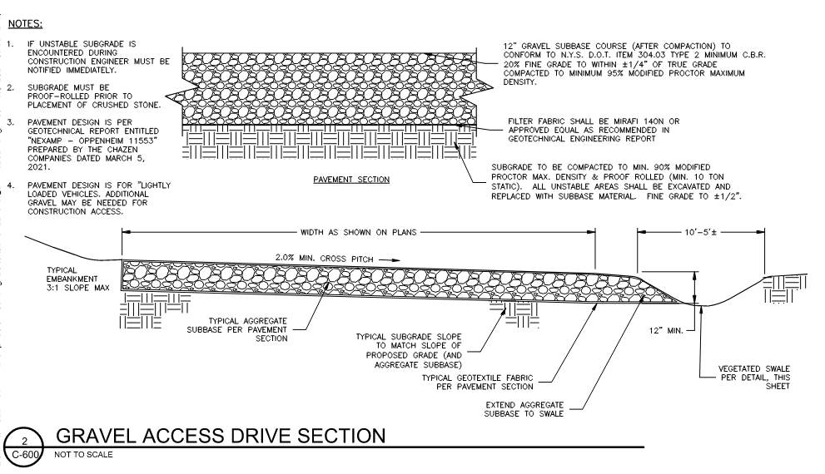
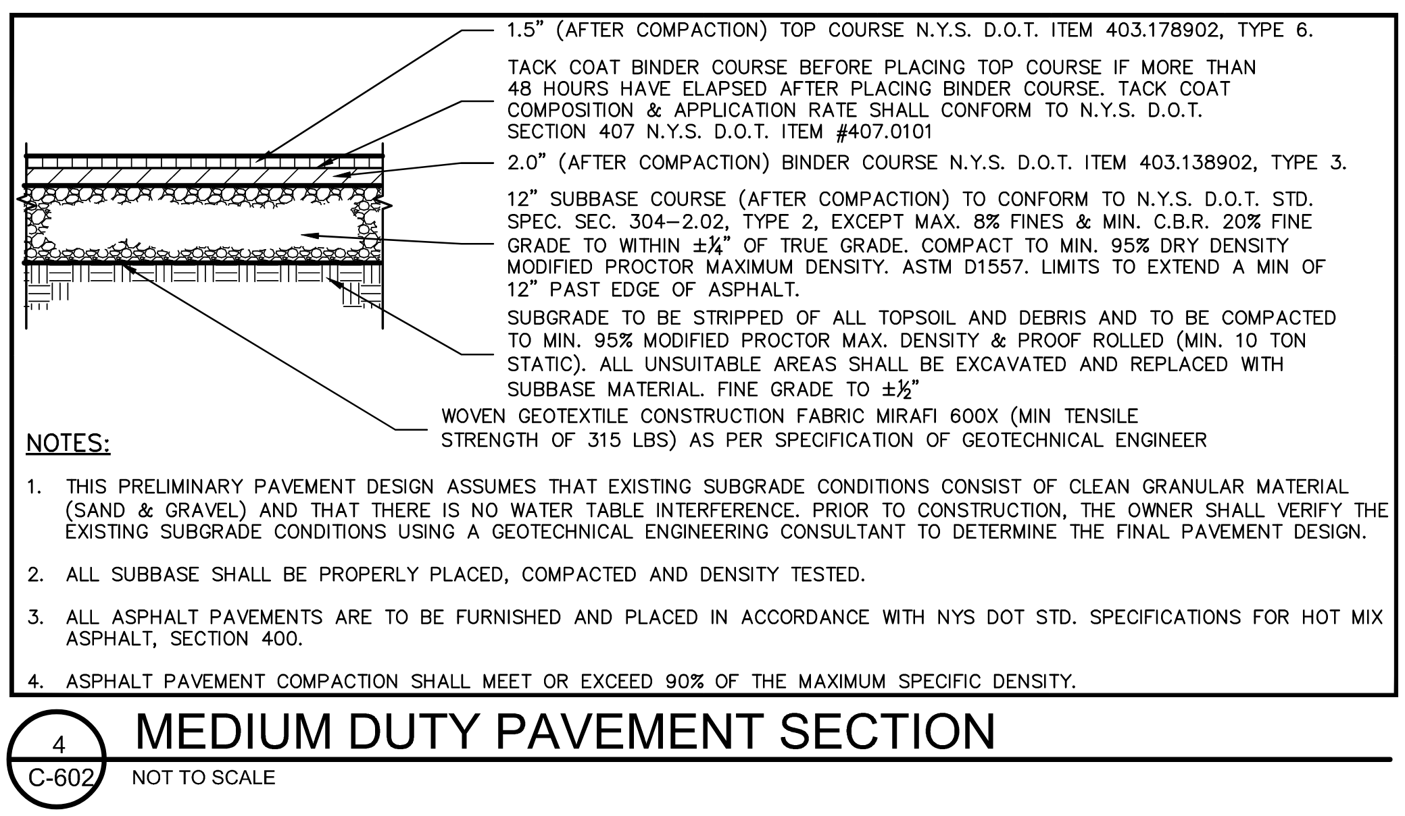
Comments from January
Access
An engineered plan for the road to include type and depth of gravel for 15 ft width road with fabric at base and finished with vibratory roller: Included in plan submission from December, 2023; portions of the proposed access road will be paved as indicated on the site plans.
Wilson Hill Road
Wilson Hill Road

Slide 20
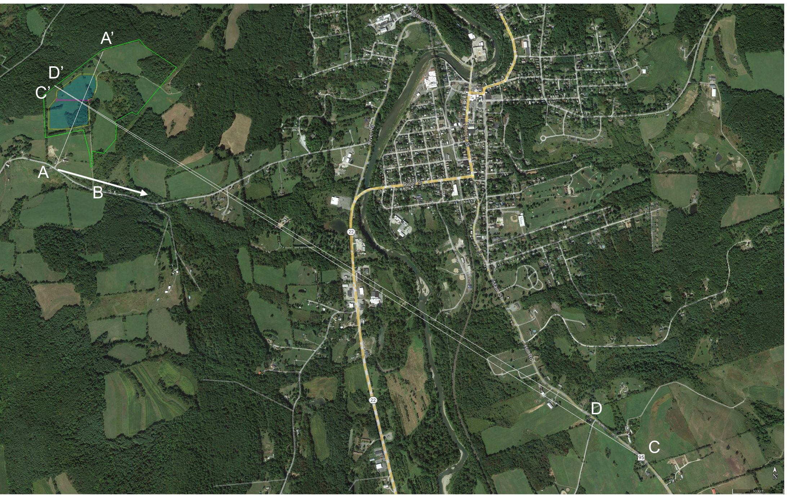
Comments from January
Jan ‘24
Visual renderings of the views from Hill Road, Route 22 Wysocki Location, Cowder house at top of Rogers Ave. with cross sections, view angles, and potential viewsheds. Additional cross sections, view angles, and a visual analysis has provided with this submission

Slide 21
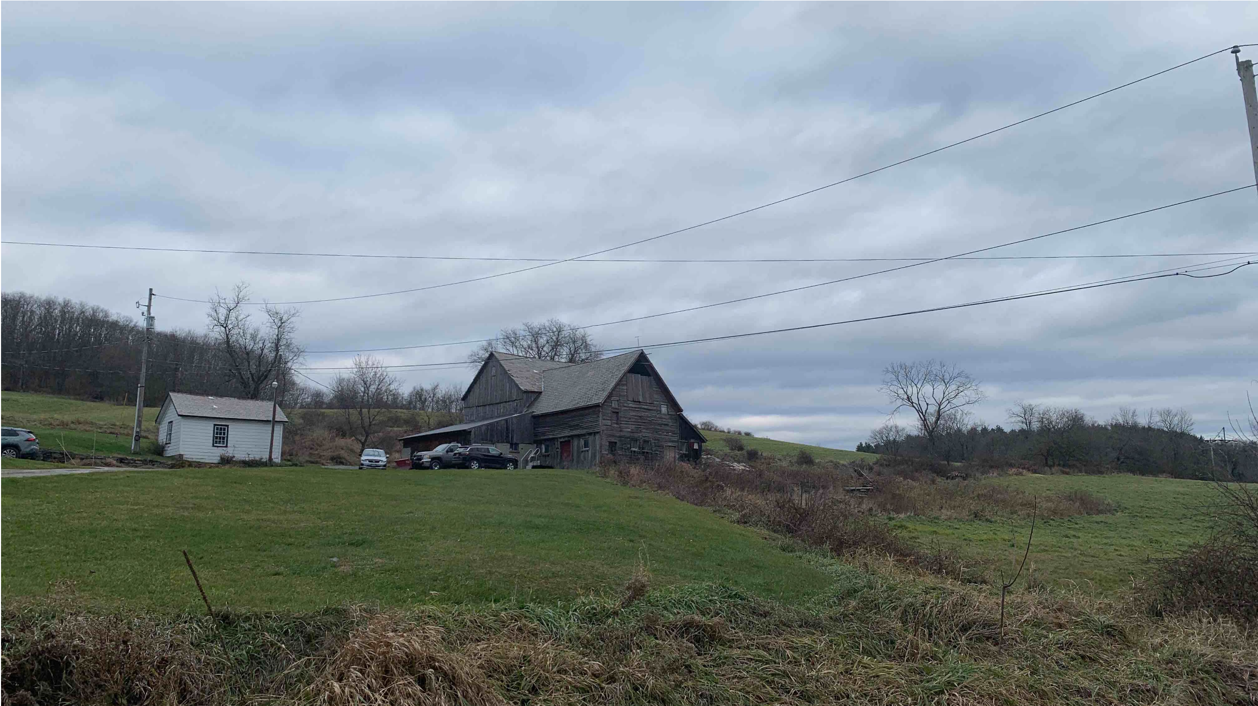
Visual Simulations – Section A – A’ – Existing

Slide 22
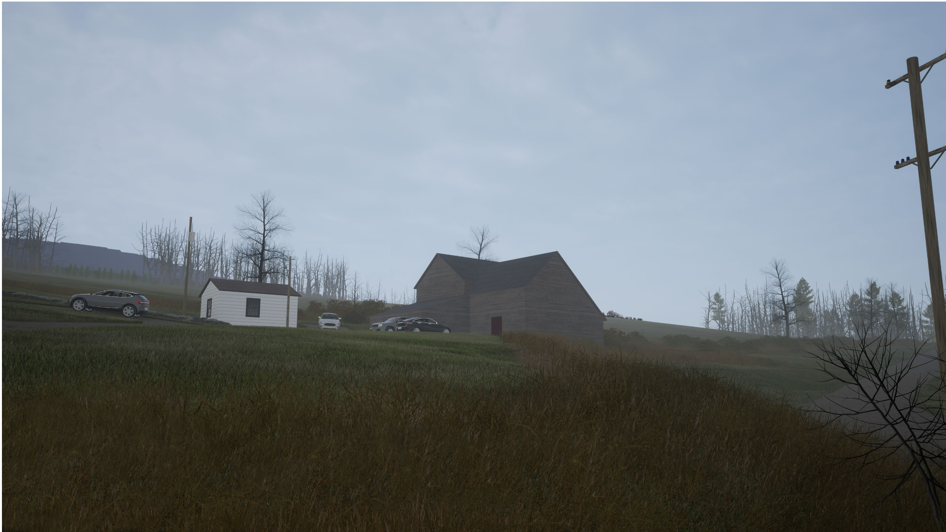
Visual Simulation – Section A – A’ – Proposed

Slide 23
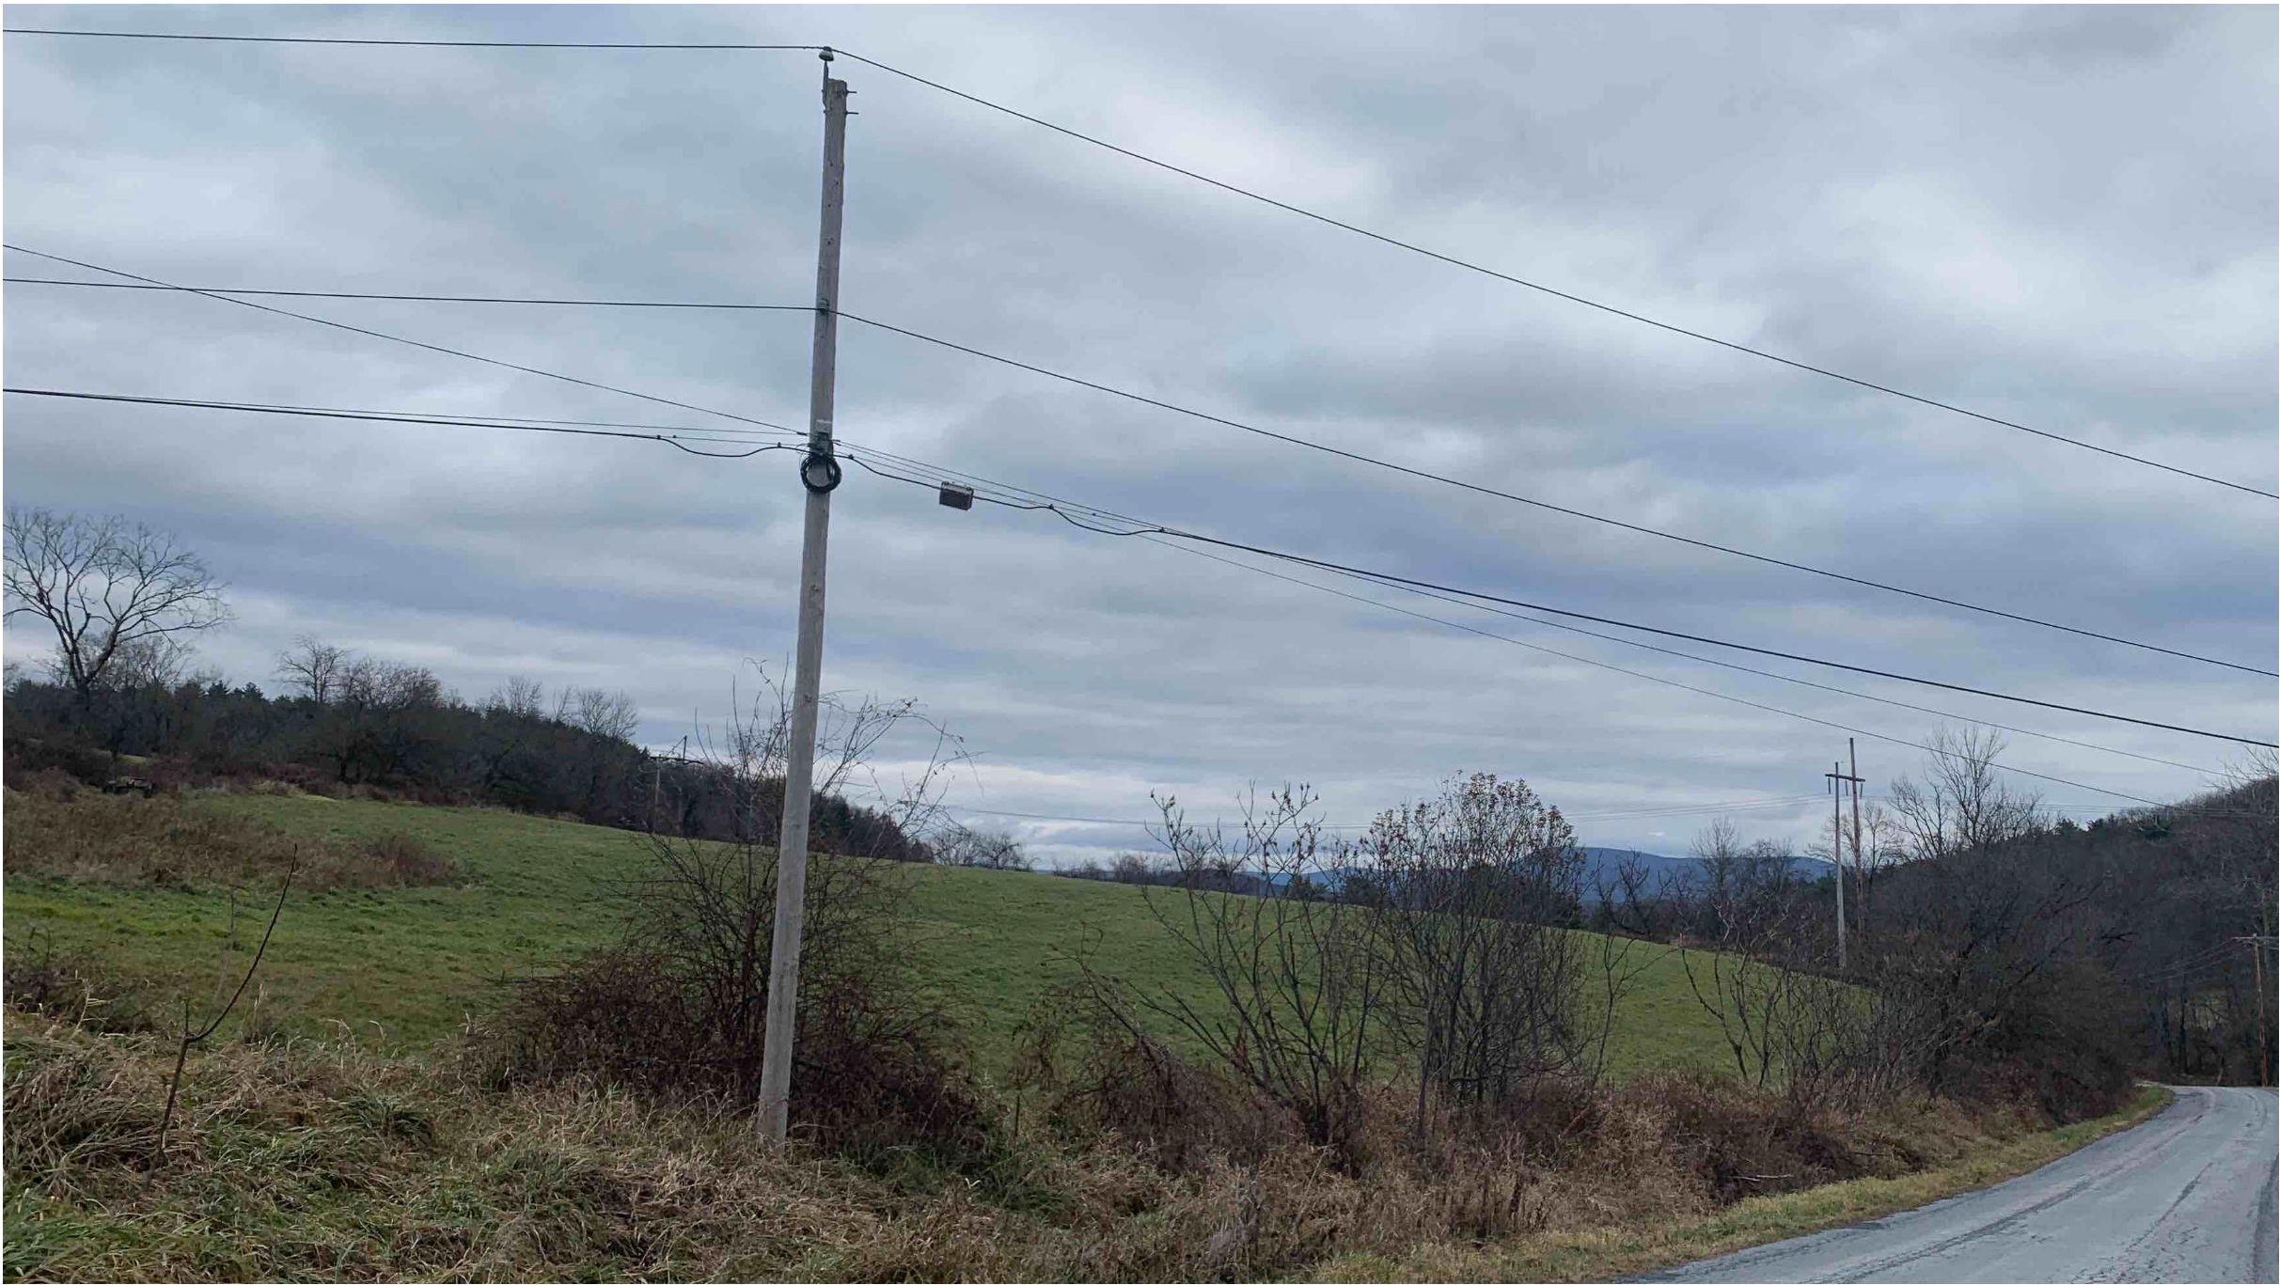
Visual Simulation – Section B – B’ – Existing

Slide 24
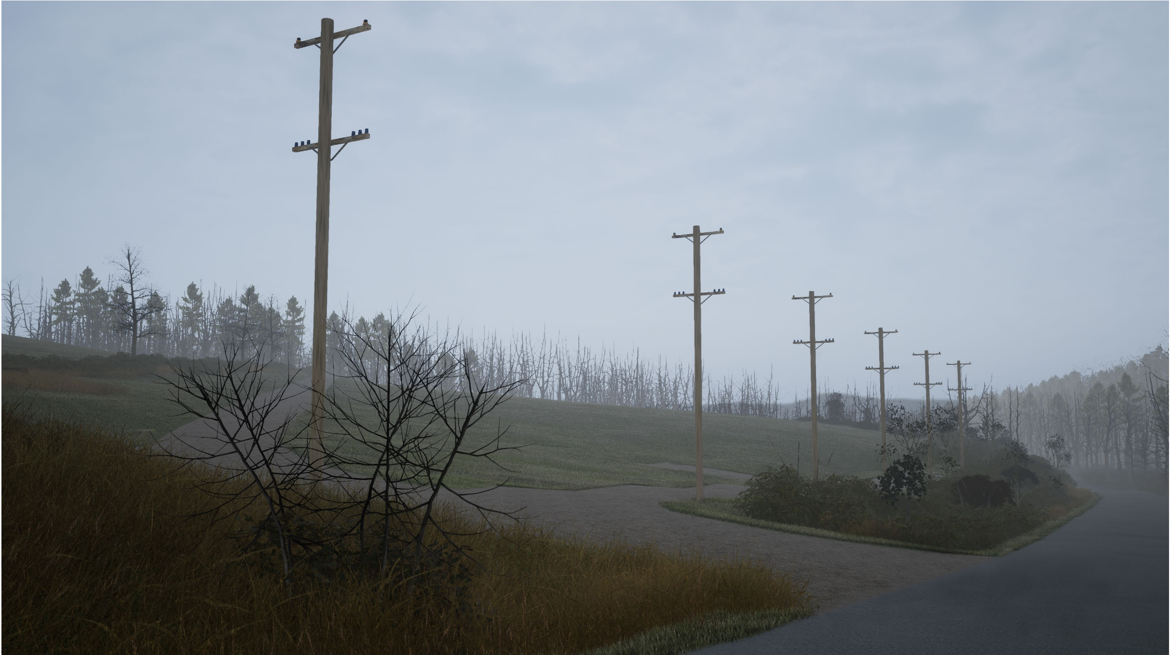
Visual Simulation – Section B – B’ – Proposed

Slide 25
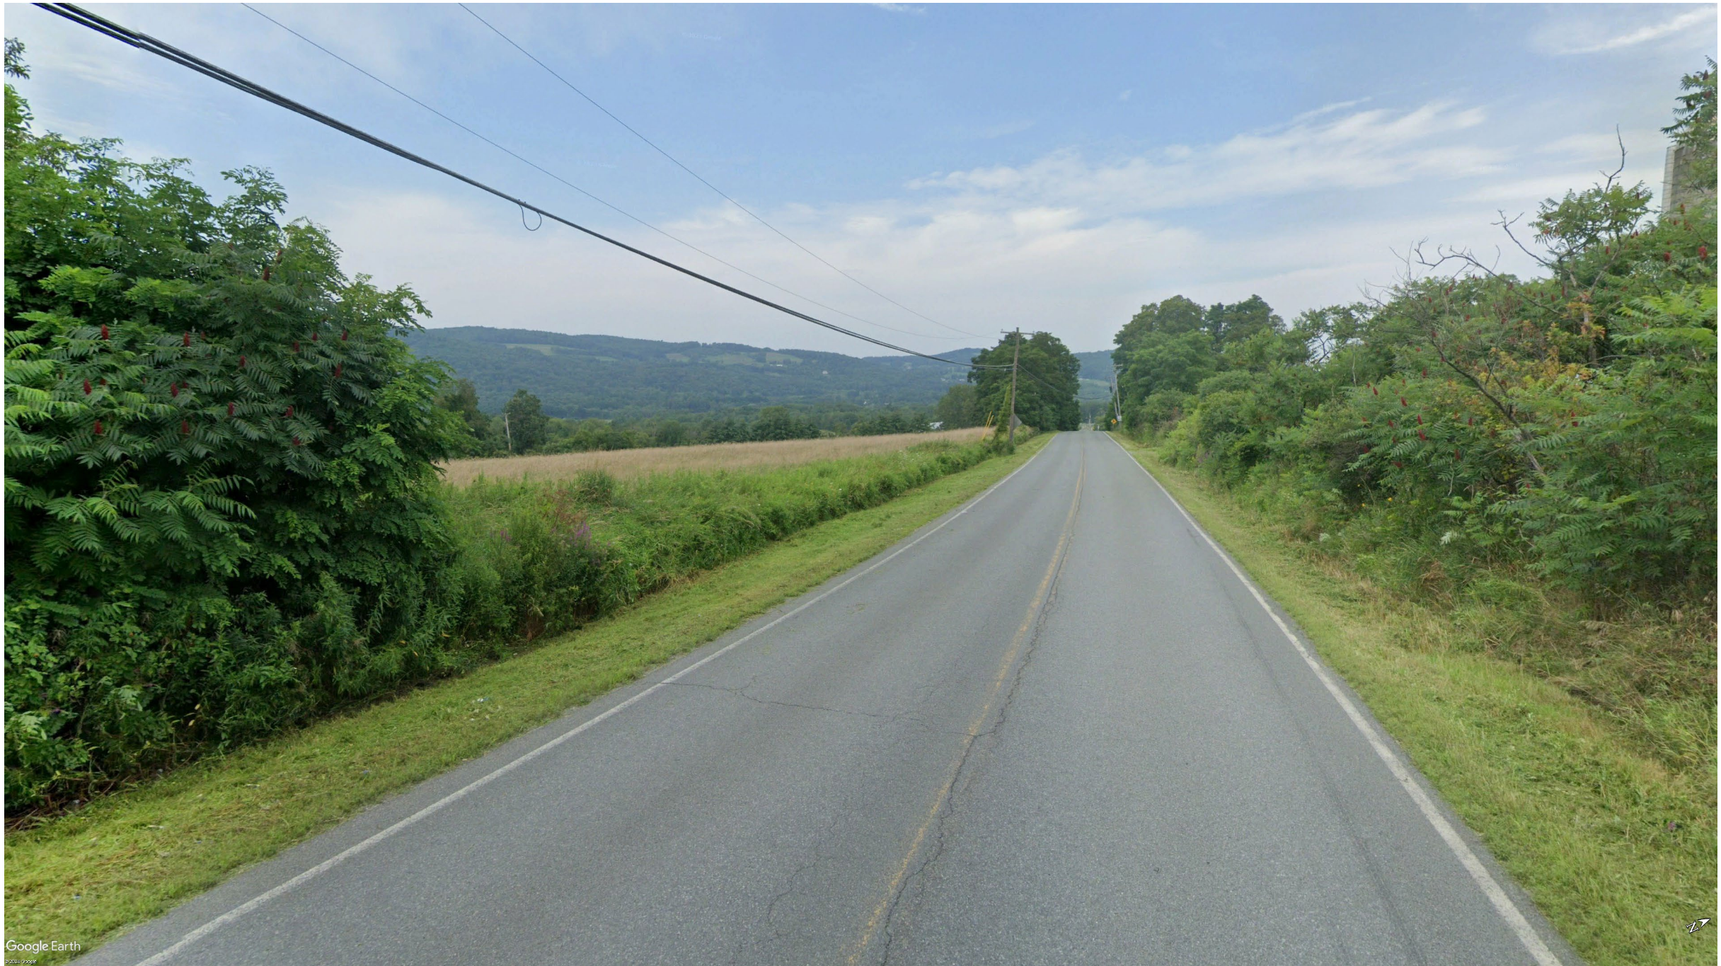
Visual Simulation – Section C – C’ – Existing

Slide 26
Visual Simulation – Section C – C’ – Proposed

Slide 27
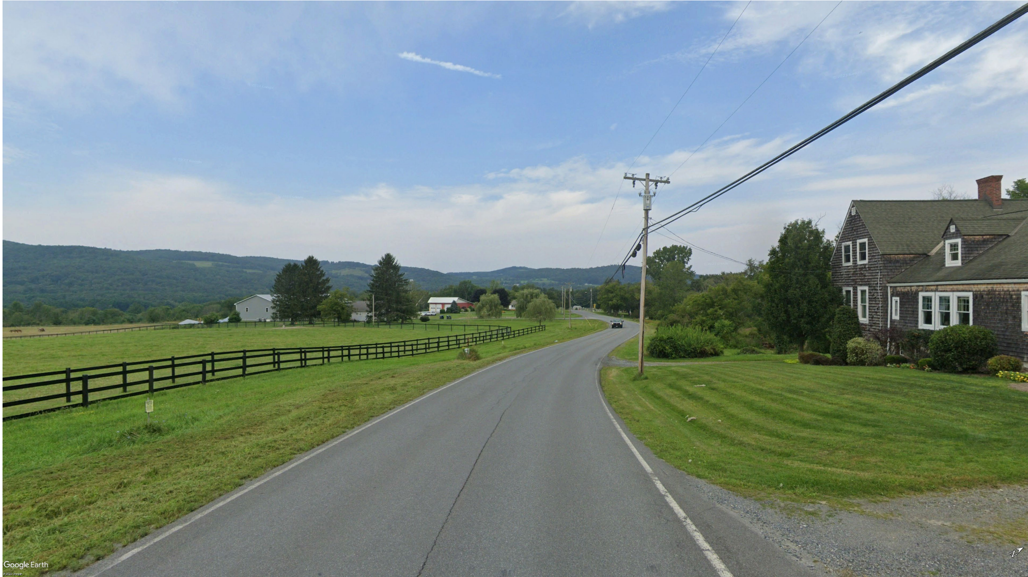
Comments from January – Section D – D’ - Existing

Slide 28
Comments from January – Section D – D’ Proposed

Slide 29
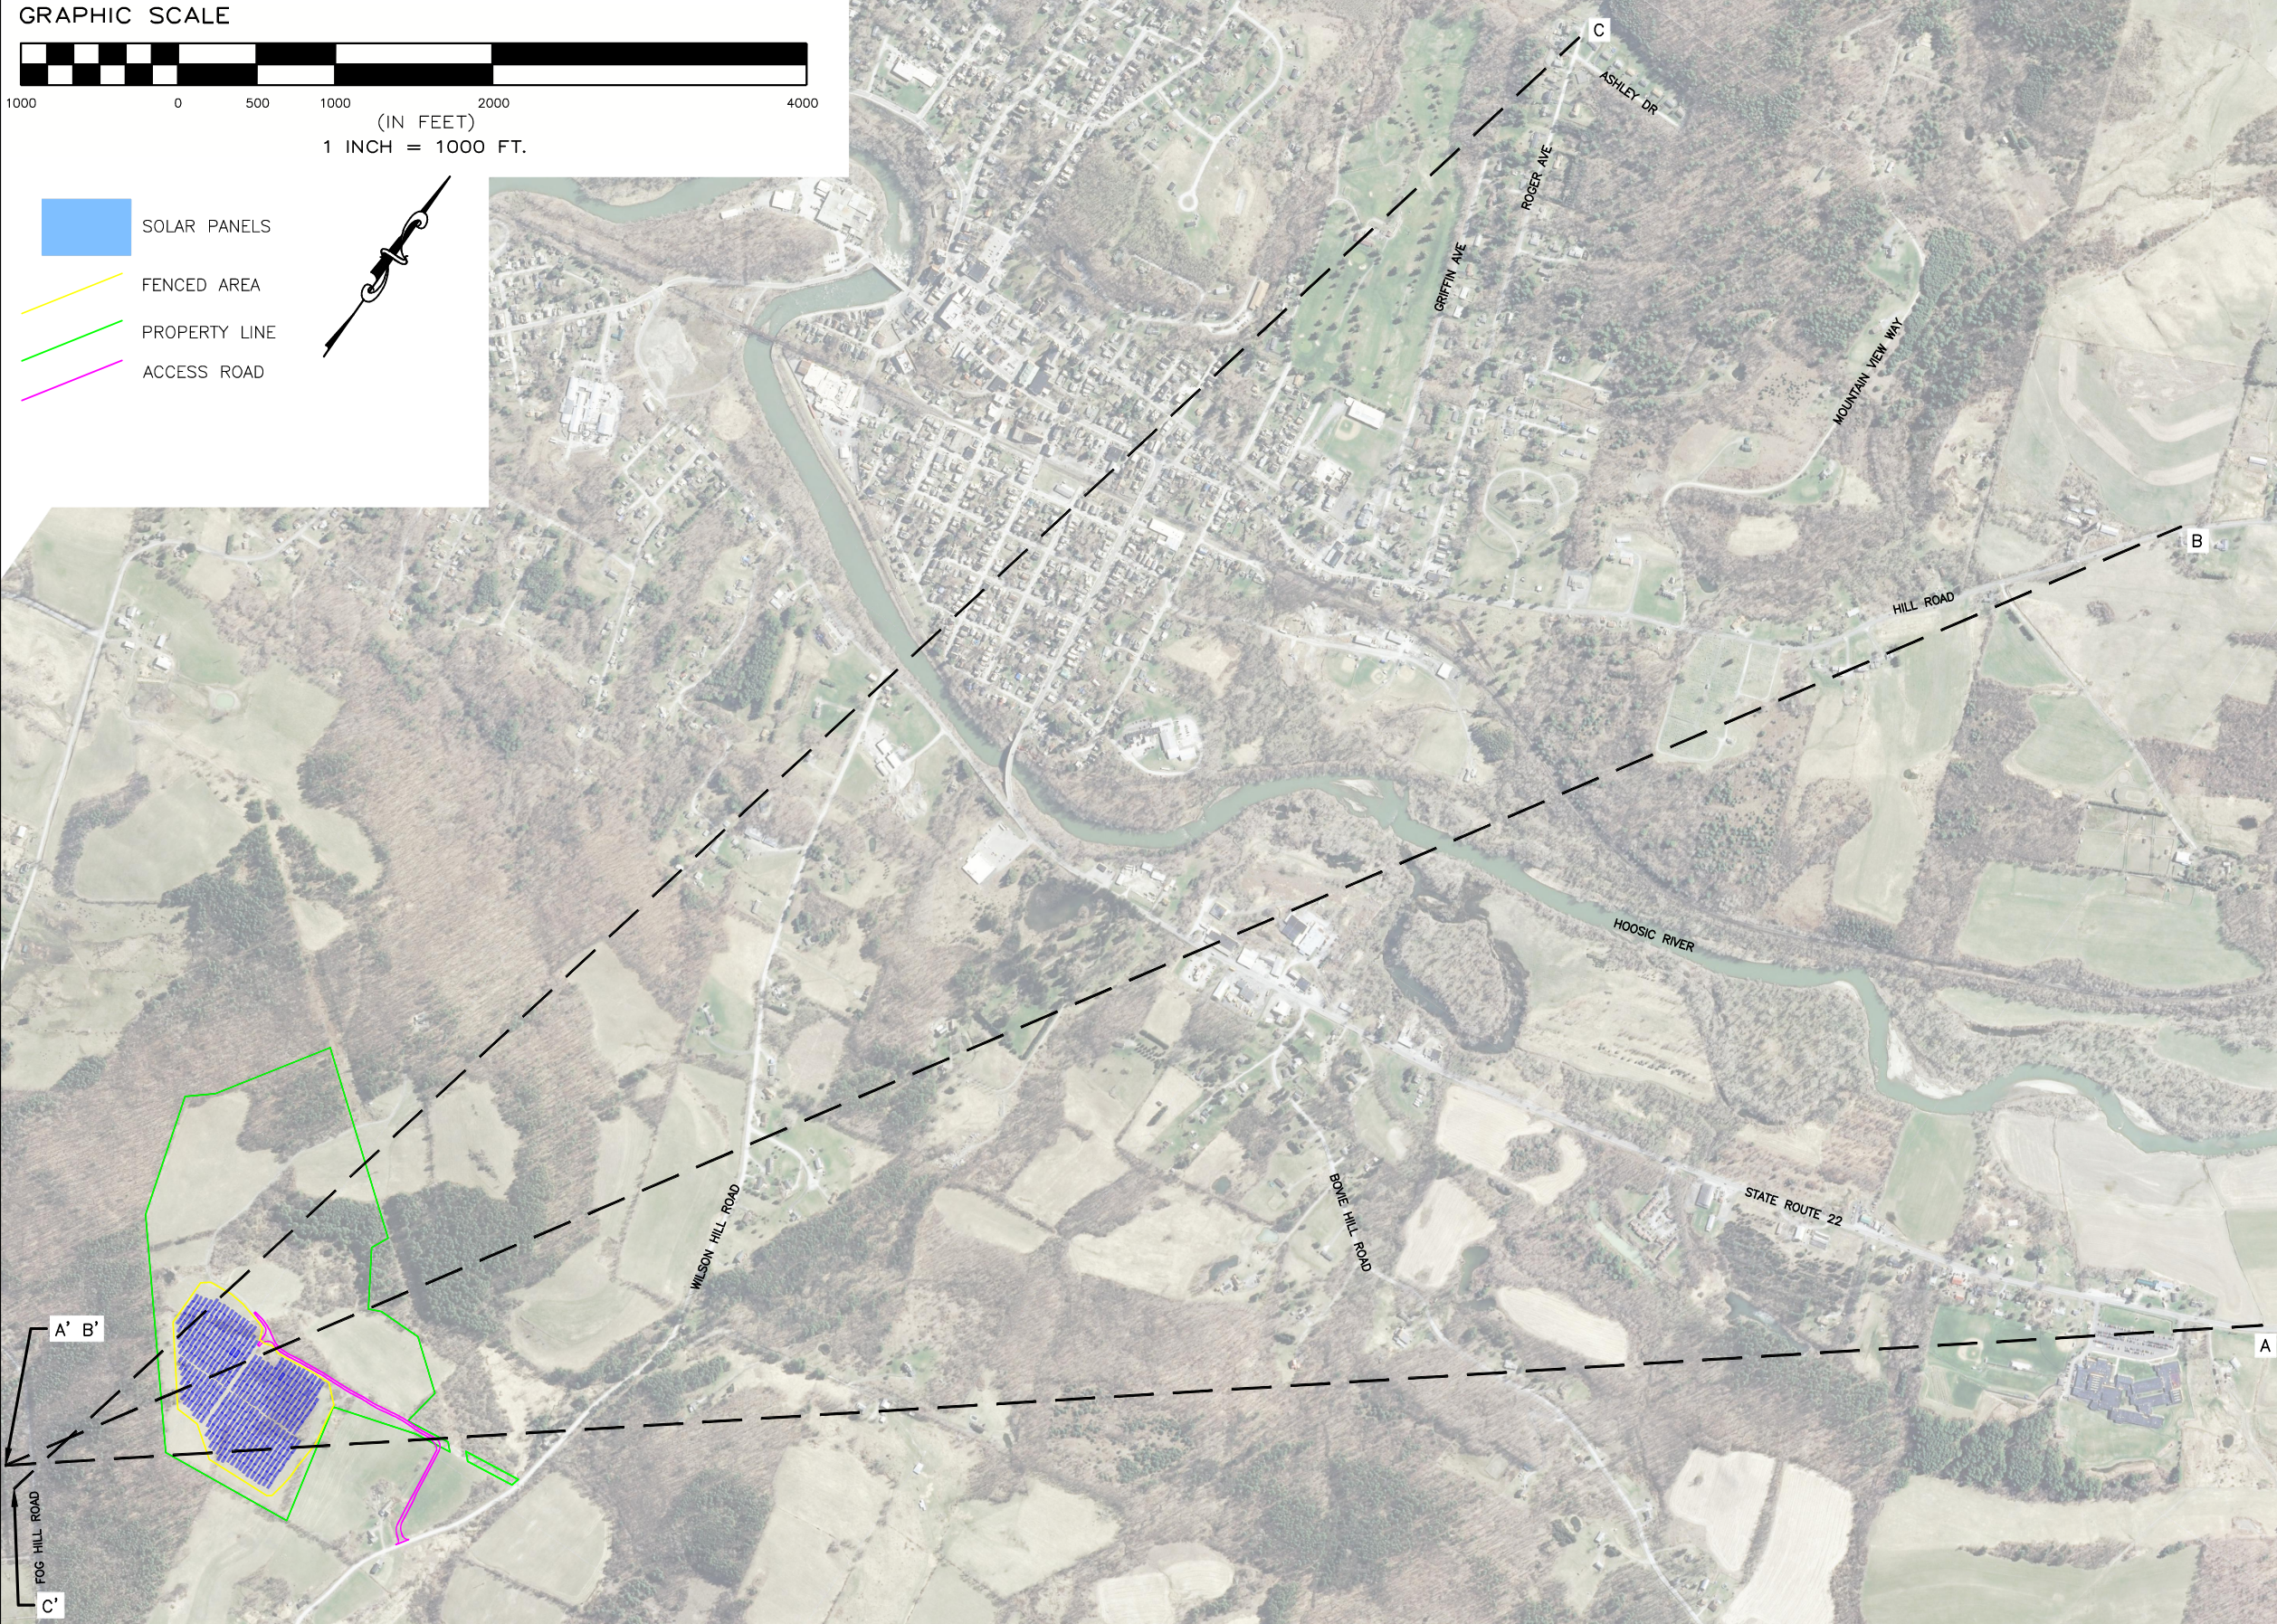
Comments from January – Visual Cross Sections

Slide 30
Comments from January – Visual Impact
Guidance from "Assessing and MItigating Visual and Aesthetic Imnpacts" – NYS Dept. Of Env. Conserv. 2019
Evaluators should assess “the potential significance of the impact using magnitude and importance, the qualities of the resource, and the juxtaposition (use viewshed or line-of-sign profiles, or both) of the project to the inventoried resource as the guide for determination.” Aesthetic impact must be evaluated in terms of designated resources, whether town, state or federally so. “While private individuals or landowners are members of the public, aesthetic impacts to a non-publicly accessible scenic or aesthetic resource do not rise to the level of significance [for purposes of SEQR].” Magnitude assesses factors such as severity, size, or extent of an action. Importance relates to how many people are going to be impacted or affected by the project, its geographic scope, and other social and environmental consequences the project proceeds or doesn’t proceed. Evaluators must consider the setting of a proposed building or structure and its impact on a designated resource – not just size alone. Context is a key element of significance especially when evaluating visual impact. The fact a project is large, by itself,” is not determinative.

Slide 31
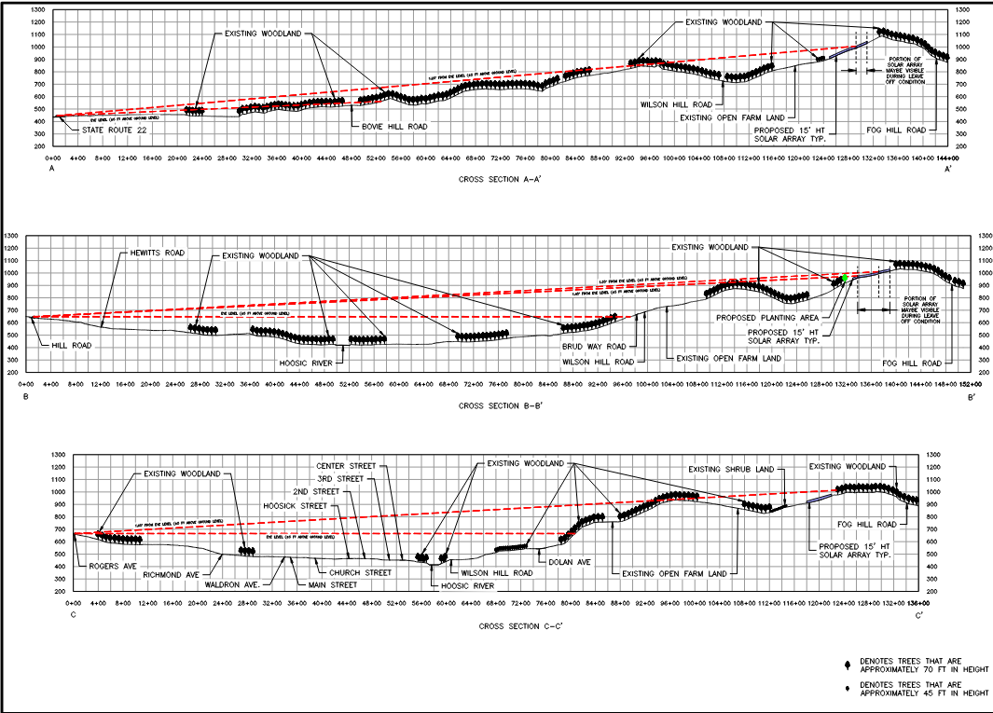
Comments from January – Visual Cross Sections

Slide 32
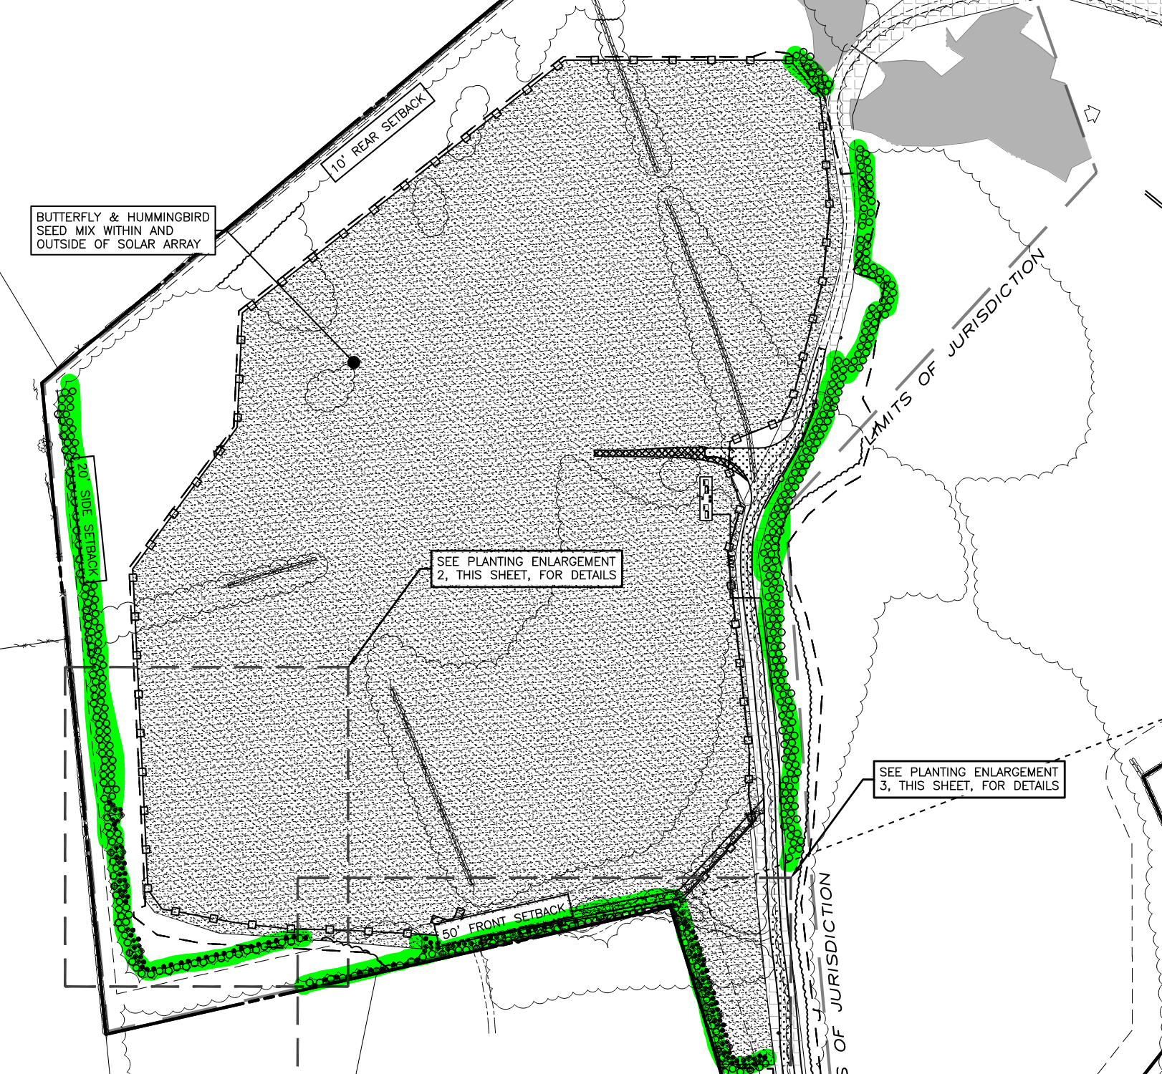
Comments from January
Trees
Plans for expanding the visual buffer on 3 sides of project to include a minimum of double row of 7ft evergreen trees along with other species and a minimum depth of six feet. The revised plans incorporate the requested landscaping buffer (highlighted in green for reference).
Wilson Hill Road
Wilson Hill Road

Slide 33
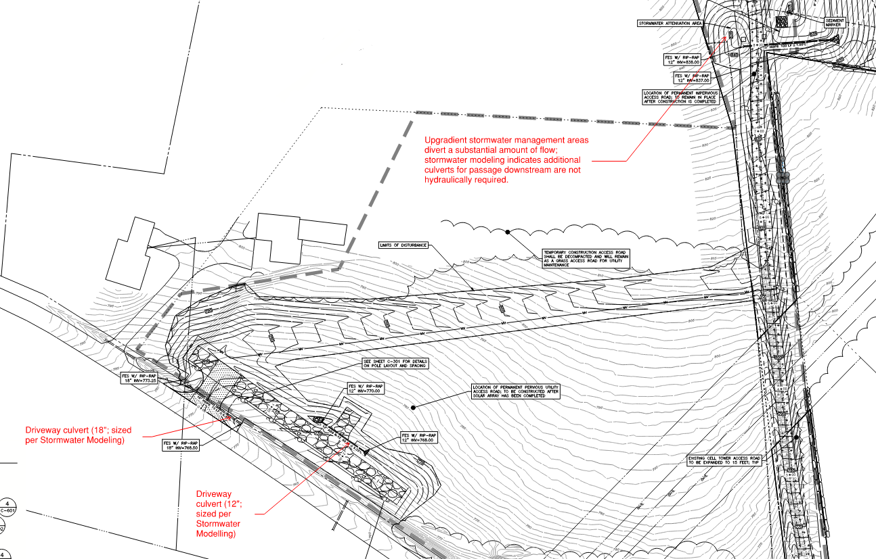
Comments from January
Drainage
Grading and drainage plans to include location and size of culverts
Wilson Hill Road
Wilson Hill Road

Slide 34
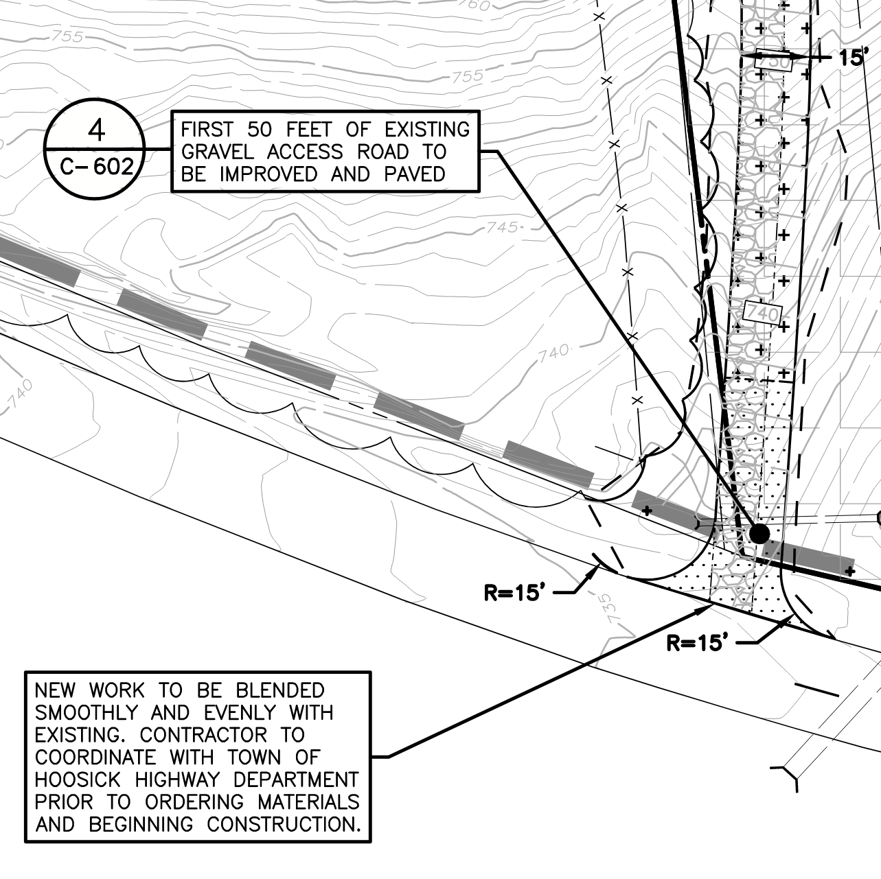
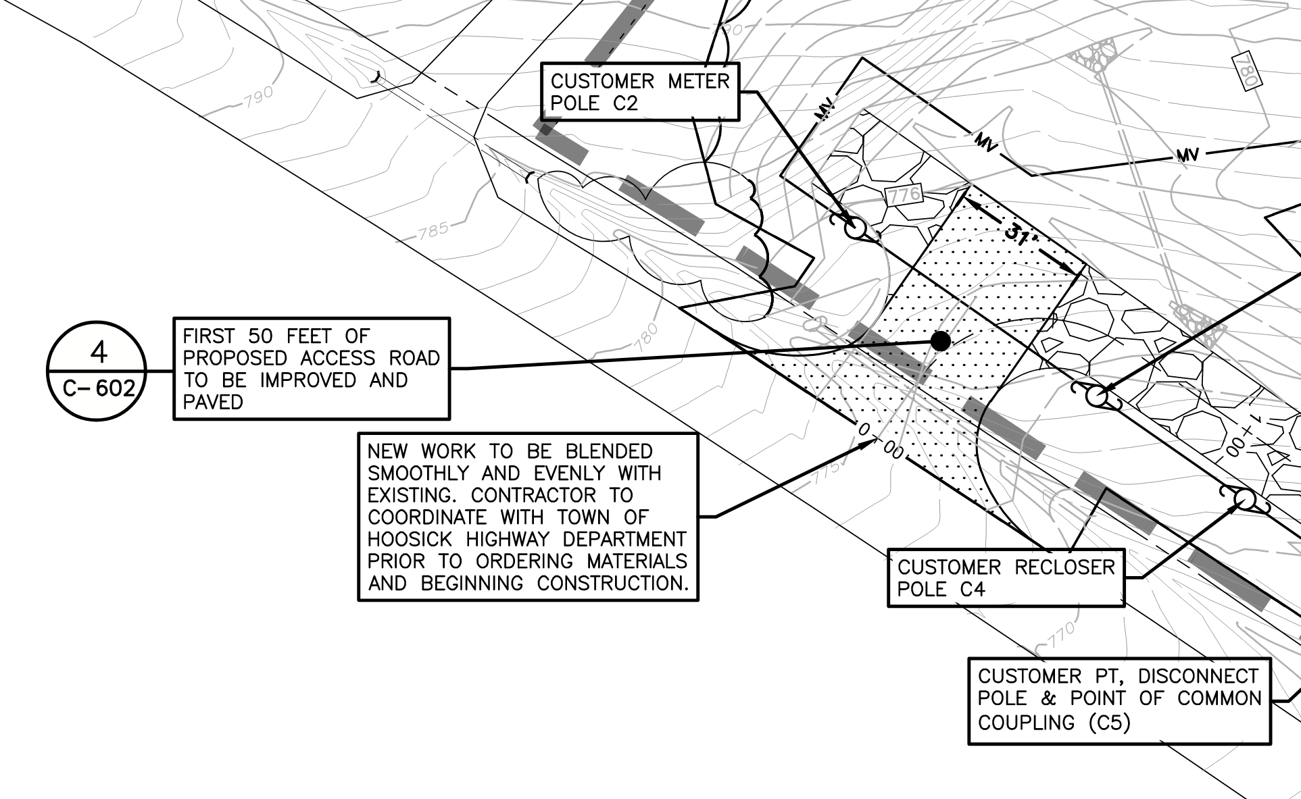
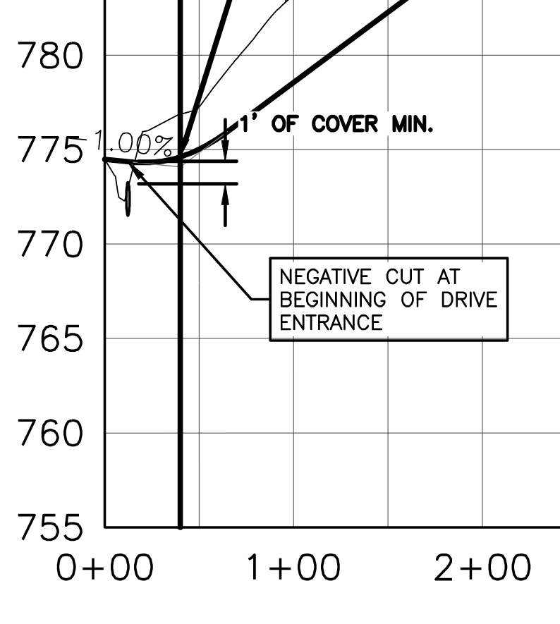
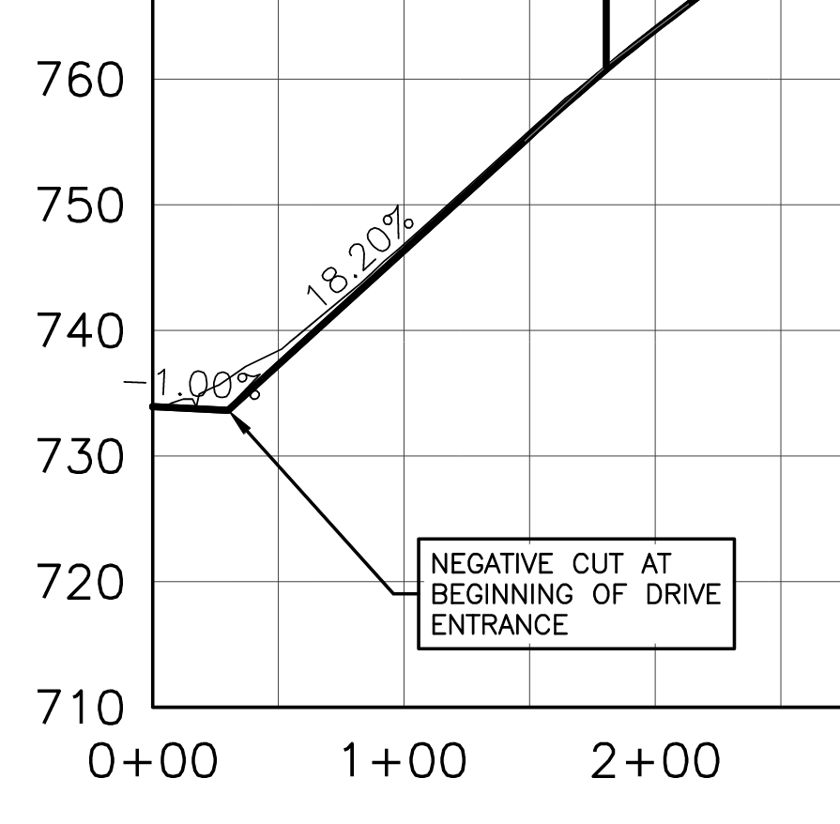
Comments from January
Jan ‘24
Road plan to include negative cut as discussed with Town Highway Department
Road plan to widen and maintain the existing cell tower access road
Site Plans have been revised to show this
Wilson Hill Road
Wilson Hill Road

Slide 35
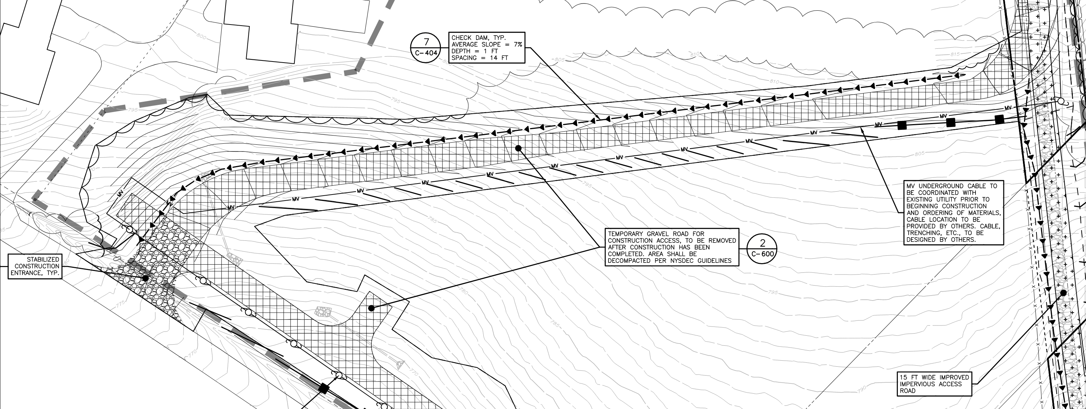
Comments from January
Jan ‘24
Road plan to insure proper water runoff control on temporary road.
Site Plans have been revised to show this
Wilson Hill Road
Wilson Hill Road

Slide 36
Comments from January
Jan ‘24
Runoff control materials to be used to insure mud and dirt don't track onto public highway
Stabilized construction entrance and weekly SWPPP inspections; construction entrance to be maintained as needed to ensure no tracking on to public roads – also road use agreement covers this.
Plans to maintain Wilson Hill Road during construction This is covered in our road use agreement.
Wilson Hill Road
Wilson Hill Road

Slide 37
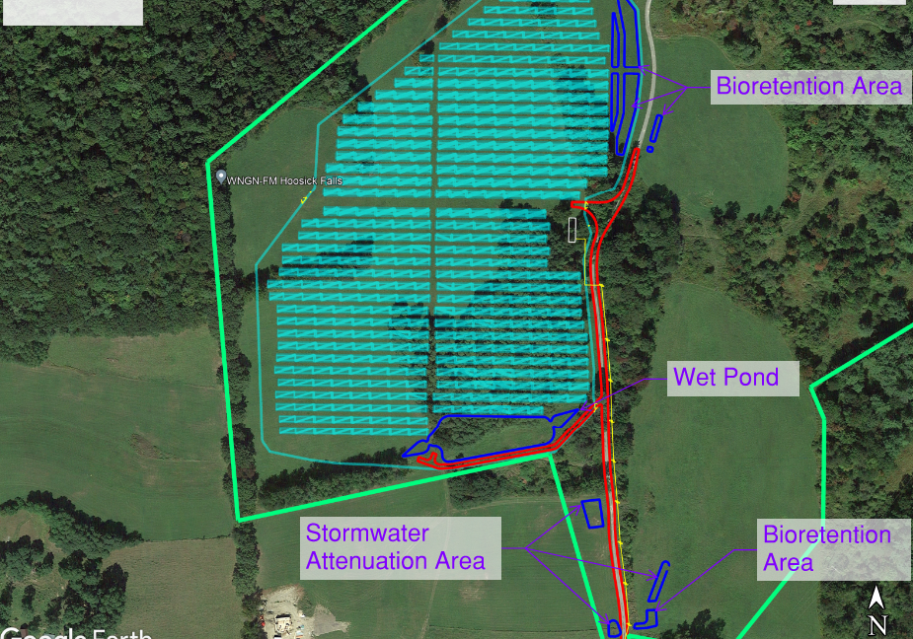
Comments from January
Jan ‘24
Robust stormwater runoff plan reflective of all site plan revisions per LaBerge Group and Town Comments - Plans show a conservative stormwater management plan.
Wilson Hill Road
Wilson Hill Road

Slide 38
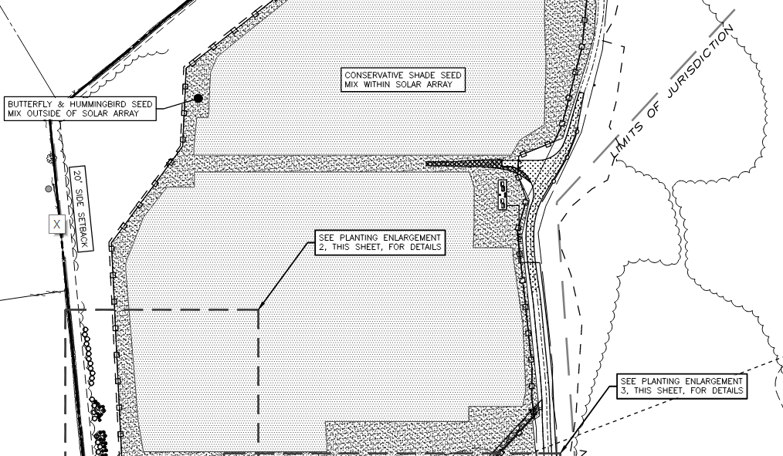
Comments from January
Jan ‘24
Plans for seeding with pollinating grasses and vegetation management Plans include provisions for a pollinator mix. Additionally, after meeting with adjacent landowner last month, we have amended our operations and maintenance plan to not use any herbicides or pesticides.
Wilson Hill Road
Wilson Hill Road

Slide 39
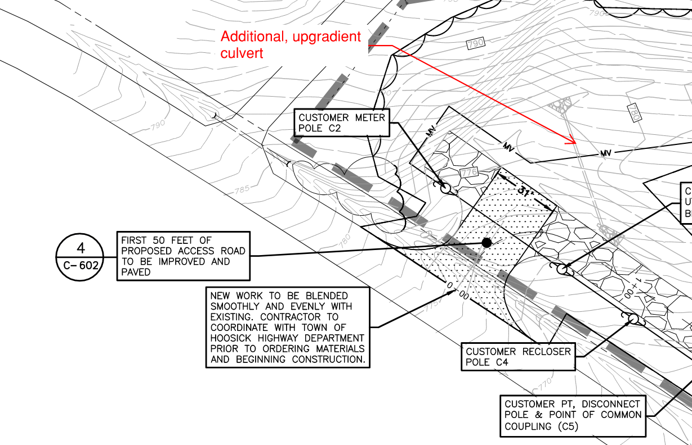
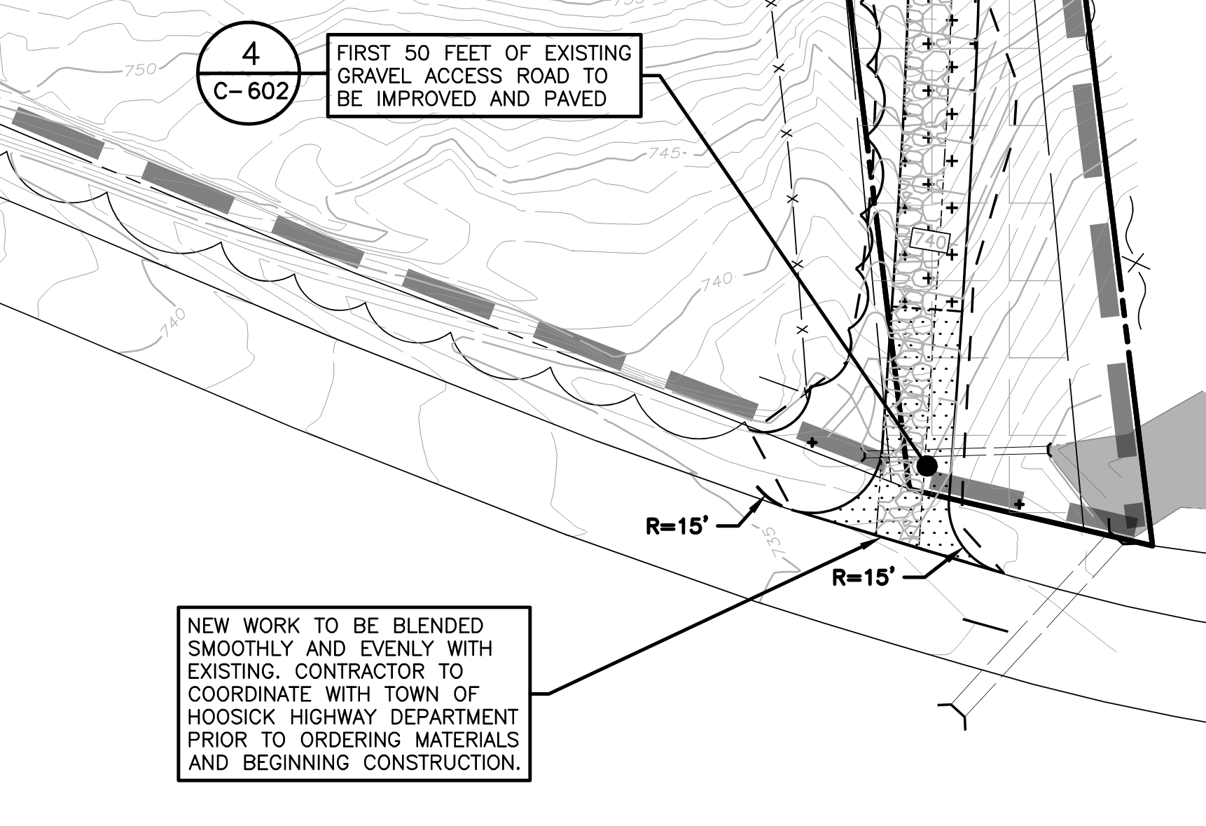
Comments from January
Jan ‘24
Vegetation Management Plan: The Operations and Maintenance plan has been revised to include language regarding ongoing maintenance of vegetation.
Road plan to include paving the first 50 feet of the existing access road and proposed stub road: The plans have been revised to reflect this request
Inclusion of additional culvert under the stub road - An additional culvert has been added as requested
Evaluation of upgradient need for additional culverts – Stormwater modelling indicates the additional upgradient culverts will not be required; the stormwater management areas to the north of the access road will divert stormwater away from the access road and reduce flows.
Wilson Hill Road
Wilson Hill Road

Slide 40
Older Comments

Slide 41
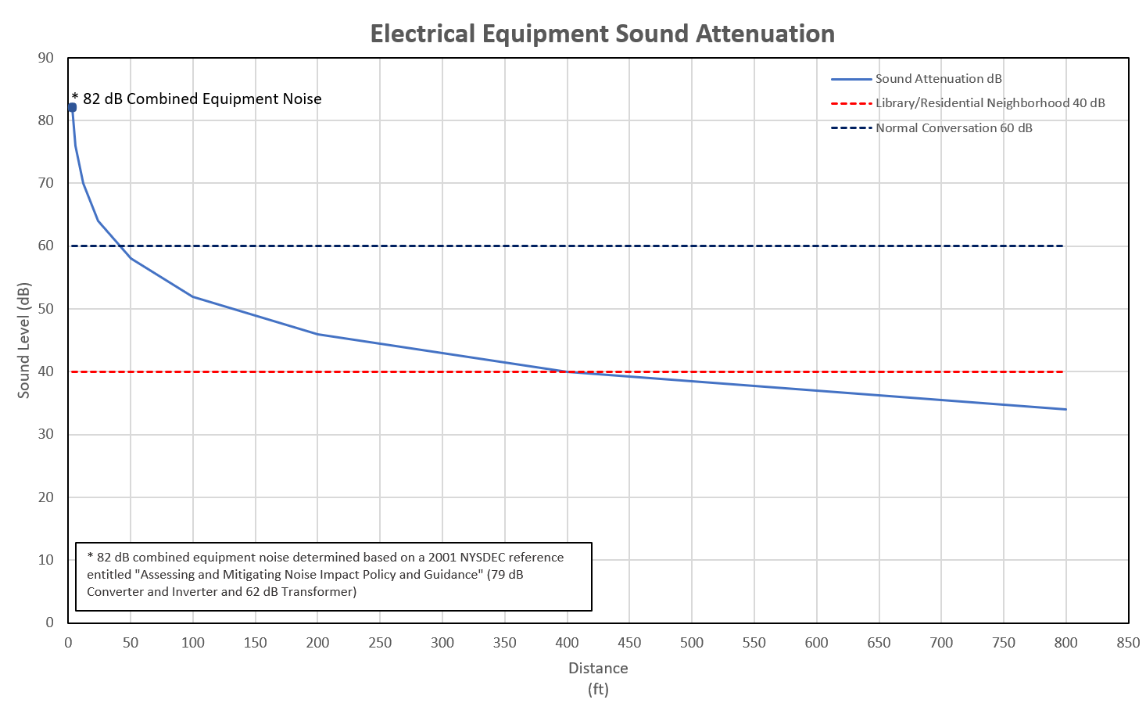
EMF
Notes:
General combined noise at the equipment pad approximately 82 dBa
Closest Property Line is about 500 Feet away; noise level will be less than 40 dBa

Slide 42
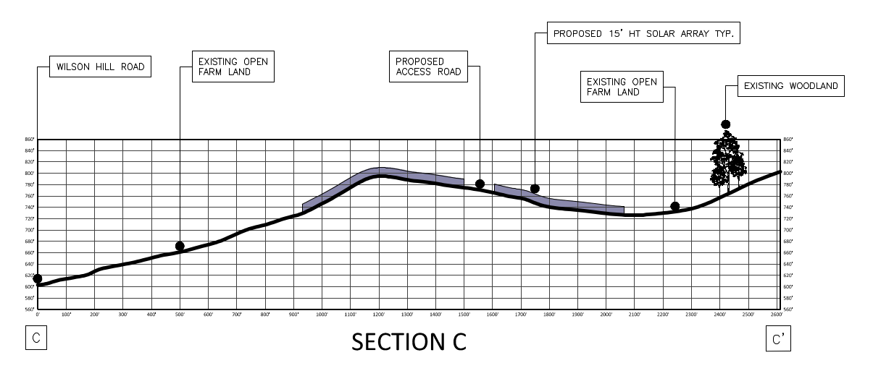
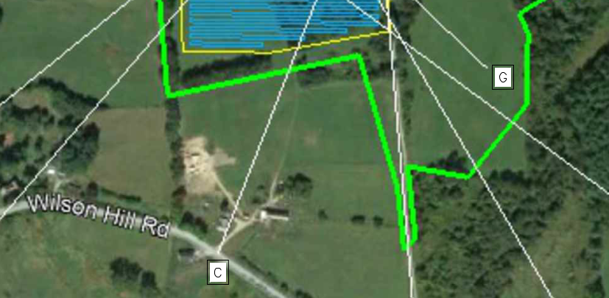
Viewshed Analysis
From the visual impact study, only one section, Section C (“receptor 3” in comments) was shown to have potential visual impact. While this section does show potential visibility, it is in fact very limited. The section cuts through a ~100ft break in the existing mature foliage that otherwise obscures the array along Wilson Hill Road.
Proposed Screening
Notes:
Additionally, supplemental vegetation has been proposed within this area which will eliminated the potential view.

Slide 43
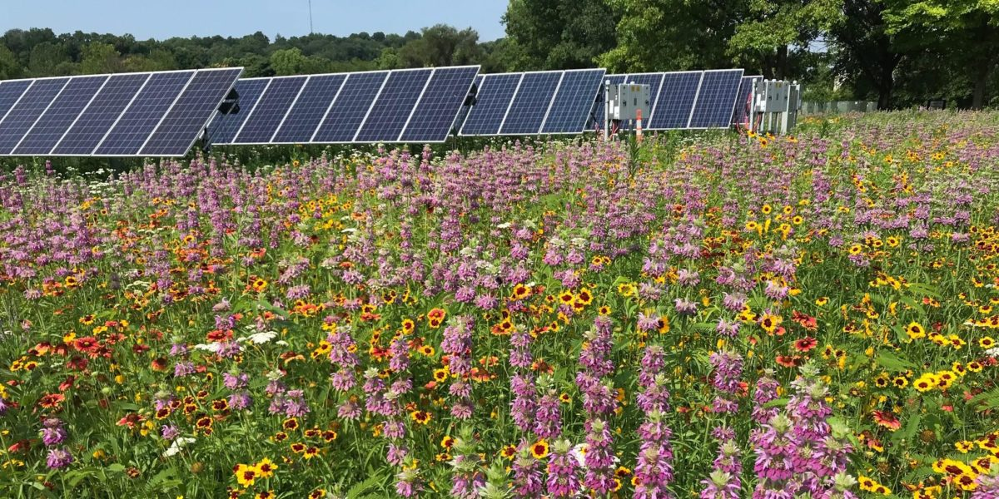
Landscaping Measures
The foliage areas around the array will largely be conserved, providing screening for the project from most viewsheds. Post-construction, areas will be planted with a pollinator supportive seedling mix. Within the fence and under the panels will be planted with low growing vegetation that prevents erosion. Outside the fence, taller growing pollinator friendly mix will be planted, and provide a greater variety for those species.

Slide 44
Operations + Maintenance
Decommissioning
As a nationwide owner operator, Nexamp provides operations and maintenance in house. We actively monitor and provide preventative, corrective, and condition based maintenance, with 100 of MWs in plants across NY. As one company that provides wrap around services for the duration of the project, Hoosick should feel confident knowing that they have one partner in the operation of this facility.
The Facility will be decommissioned by completing the following major steps: Dismantlement, Demolition, and Recycle or Disposal; and Site Stabilization, as further described below. Nexamp will post a decommissioning bond with the Town to ensure proper decommissioning in any scenario. Nexamp will remove all equipment and material from the site, and strive to recycle and reuse as much as commercially practicable – as part of a commitment to a sustainable grid.

Slide 45
Town Permitting
The applicant is seeking Special Use Permit approval from the Town of Hoosick Zoning Board. Through that process, the applicant will also seek a SEQR declaration. Other approvals outside of Hoosick’s jurisdiction include:
239-m referral to Rensselaer County – Received, November, 2023
NYS Agriculture and Markets NOI – To be submitted prior to construction
NYS DEC SPDES water permit – To be submitted prior to construction
NYS SHPO consultation – Received, April, 2023
FAA no impact determination – Notice Criteria Not Exceeded, February, 2023
USFWS no impact letter – Received, February, 2023
Zoning Board:
SEQR Type I
Special Permit

Slide 46
EMF
Notes:
2017 NC State Study on Health and Safety Impacts of Solar Farms
Panels don’t generate Electromagnetic Fields, only electrical equipment inverters / transformers
Once 10 ft away phone in pocket or bedside table has higher impact
Certainly outside fence no impact

Slide 47
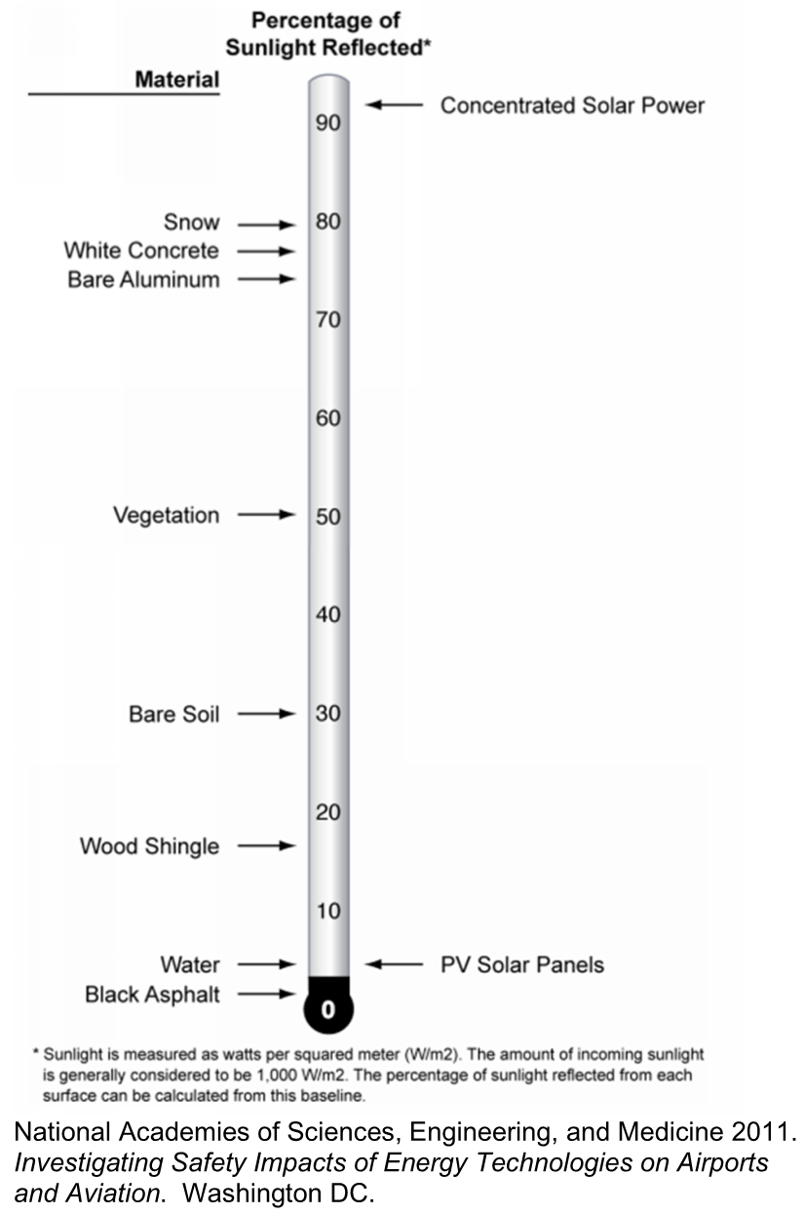
Solar Panel Glare

Slide 48
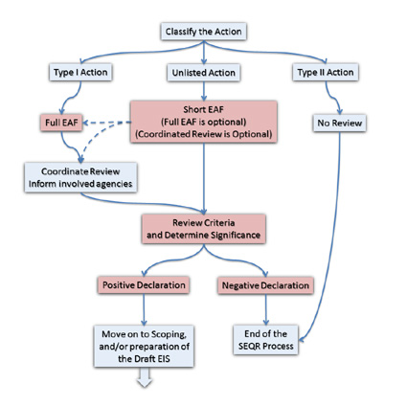
SEQRA Process
Classify the Action
Type I – Full Environmental Assessment Form (EAF)
Projects that could require further review
Nonresidential project disturbing more than 10 acres
Full EAF Part 1 - Submitted
Type II Actions – Short EAF
Unlisted Actions – Short / Full EAF
Initiate Coordinated Review
Notify Potentially Involved / Interested Agencies
Requesting to set Public Hearing tonight and begin SEQRA Parts 2 & 3 Review
Review Potential Project Impacts – Full EAF Part 2
Determine Project Significance – Full EAF Part 3
SEQRA Process

Slide 49
Thank you

